Slide 2
Dynamics 365 Continuous Integration / Delivery
Chris Clark Enterprise Architect, PowerObjects

Slide 3




My Experience
Dynamics 365 for Sales
Financial
Telecommunications
Government
Healthcare
Energy / Oil & Gas
Retail
Customer 360, Azure, Collab, Multi-Channel, BI, AI, USD, Mobile, Integrations, Security, Custom, Performance
Chris.Clark@HCL-PowerObjects.com
https://www.linkedin.com/in/chrisclark/
25+ years dev (not the same bad year over and over)
dBASE III, Clipper, FoxPro
Turbo Pascal, Turbo C
Visual Basic, SQL Server
Java
.NET
Dynamics CRM 4.0, 2011, 2013, 2015, 2016, 365

Slide 4

What’s in it for me?
Philosophy 26%
History – Lean Production to Lean Software
Defined – CI, CD, CD^{Too}
Benefits – High Performance Companies
Setup For Success – More than CI/CD
Team Development Models
Technical 74%
VSTS – Build / Release Tasks
Release Management - VSTS
Jenkins Server – Pipeline
Operations / Monitoring
WII FM

Slide 5
History

Slide 6

History of Lean Production to Lean Software
1785, France,
Blanc gun shop
1798, Conn,
Eli Whitney Gun Contract
1914, Detroit, Henry Ford
1921, Detroit, Kiichiro Toyoda
1936, Japan, Toyota First Car
1948-1975, Toyota Production System
1990, Lean Production
1991, Grady Booch, OO Design with Apps
1995, Scrum
1996, Extreme Programming
2003 Lean Software Dev: An Agile Toolkit
2007, Scaled Agile Framework

Slide 7
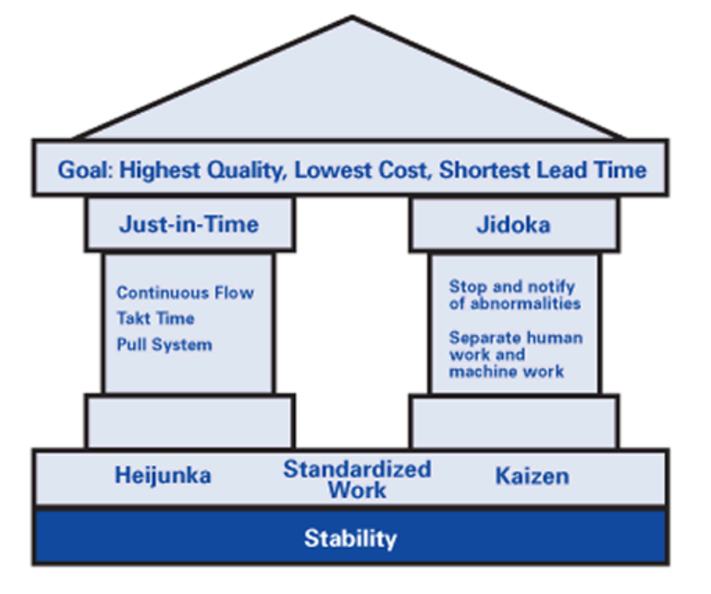
Toyota Production System
Continuous improvement
Respect for people
Management decisions based on a long-term philosophy
The right process will produce the right results
Add value to the organization by developing your people and partners
Continuously solving root problems drives organizational learning
Jidoka - work stops immediately when a problem first occurs
Heijunka - Japanese word that means “leveling.” Meet demand while reducing while reducing wastes in production and interpersonal processes.

Slide 8

CHANGE
GOOD
Kaizen, also known as continuous improvement, an approach to systematically seek and achieve small, incremental changes in processes in order to improve efficiency and quality. Continuous improvement is the responsibility of every worker, not just a selected few. Kaizen can be roughly translated from Japanese to mean "good change."

Slide 9
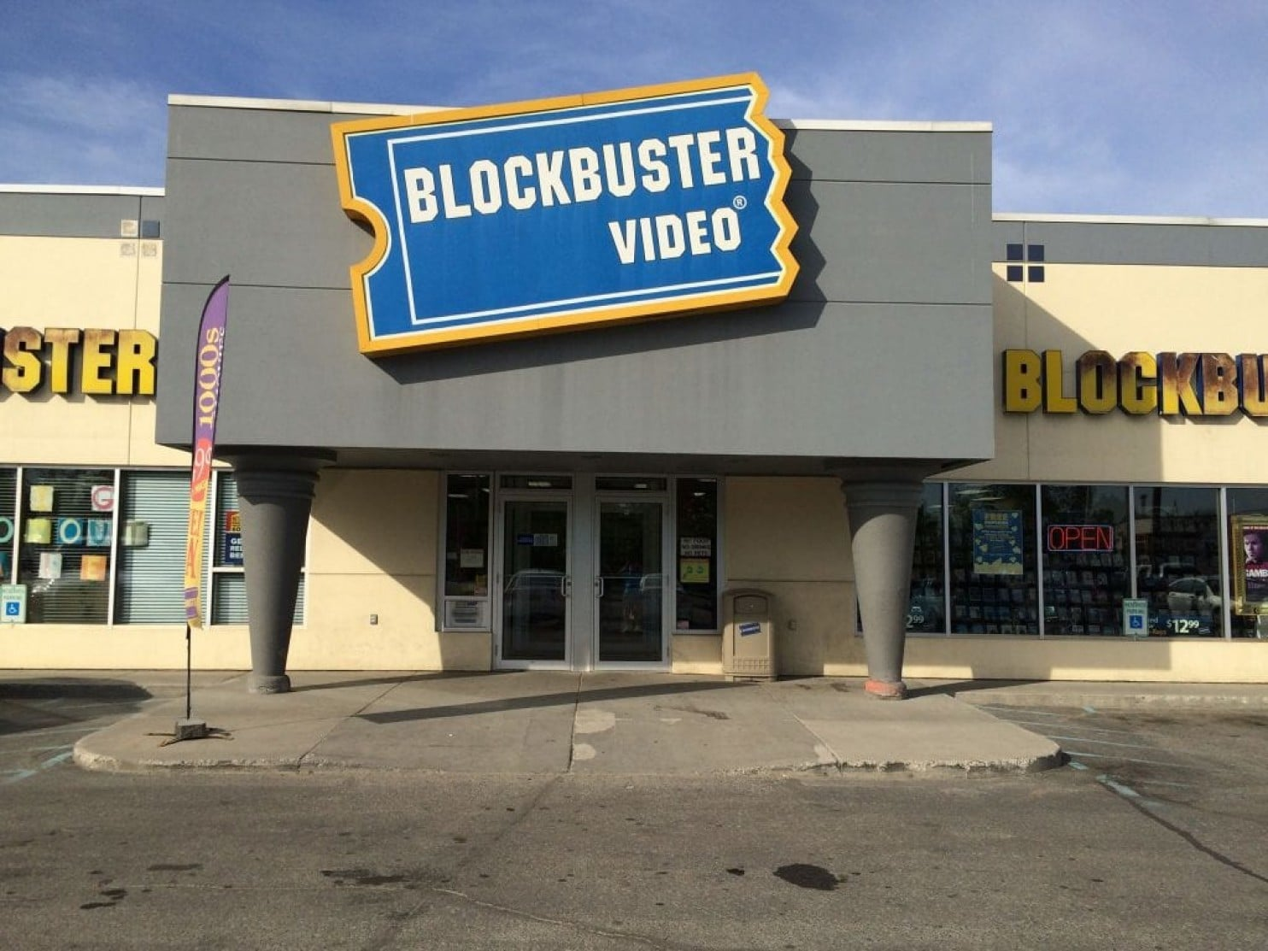

Blockbuster survives in Alaska
Where dark, long winters and expensive WiFi have helped maintain a core group of loyal customers.

Slide 10
Defined

Slide 11

Continuous Integration (CI)
Continuous Integration is the practice of merging all developer working copies to a shared mainline several times a day.

Slide 12
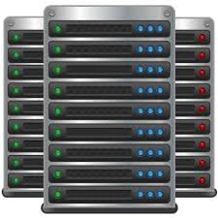
Continuous delivery (CD)
Fast, Repeatable, and Reliable delivery of features to stakeholders in any environment.
DEV
SIT
SAT
UAT
PERF
TRAINING
PROTOTYPE
VISIONING

Slide 13
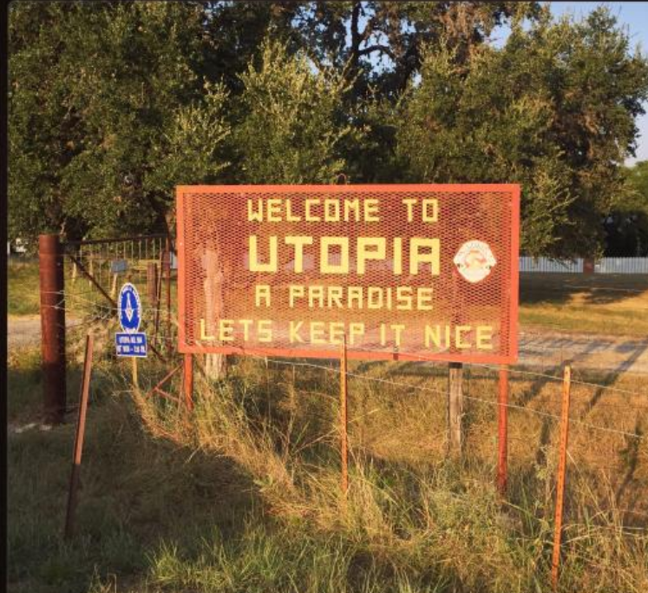
Continuous deployment (CD² or CD^{too})
Fast, Repeatable, and Reliable delivery of features to users in production
PRODUCTION

Slide 14
Continuous Delivery != Continuous Deployment
Continuous Delivery
DEV
SIT
SAT
PERF
UAT
PROD
Auto
Manual
Manual
Manual
Manual
Continuous Deployment
DEV
SIT
SAT
PERF
UAT
PROD
Auto
Auto
Auto
Auto
Auto

Slide 15
Story / Requirements Management
Release
Planning
Release 1
Release 2
Sprint
Planning
Sprint 1
Sprint 2
Sprint 3
Sprint 4
BA Leading
Define Stories
Requirements
Feature Files
BA Leading
Define Stories
Requirements
Feature Files
BA Leading
Define Stories
Requirements
Feature Files
Build Backlog
Sprint 1
DEV
SIT
SAT
PERF
UAT
PROD

Slide 16
Build Process
Release
Planning
Release 1
Release 2
Sprint
Planning
Sprint 1
Sprint 2
Sprint 3
Sprint 4
Sprint 1
DEV
SIT
SAT
PERF
UAT
PROD
Automated Solution Export
Check Into Source Control
Static Code Analysis
Automated Unit Testing
Automated Solution Deploy
Automated End-to-End Testing
Manual Functional Testing
Defect Triage
Automated Load Testing
Performance Remediation
Defect Triage
Data volumes similar to production
Infrastructure similar to production
User Acceptance Testing
User Training
Production Validation
Production Users

Slide 17
Benefits

Slide 18
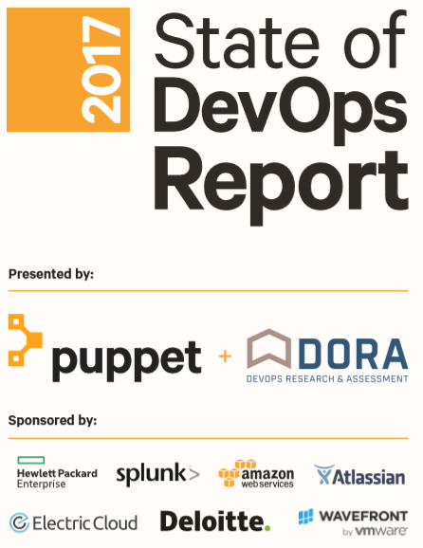
Survey Says?
6 years & 27,000 surveyed
New findings about transformational leadership, automation practices, continuous delivery, lean product management, and DevOps in not-for-profits and organizations that use off-the-shelf software
https://puppet.com/resources/whitepaper/state-of-devops-report

Slide 19
High Performance* Organizations
Have Transformational Leaders
Automate Everything
Embrace DevOps Practices
Loosely Coupled Architectures
Lean Product Management
Branch Less
Get Results
*as measured by productivity, profitability, and market share
Reference: https://puppet.com/resources/whitepaper/state-of-devops-report

Slide 20
1. Have Transformational Leaders
Vision
Understands their team and aligned to organization goals
Positive communications
Embraces change
Encourages passion and motivation
Provides positive encouragement
High expectations for team members
Intellectual challenges
Challenges team on assumptions
Encourages validation
Encourages team to constantly ask new questions
Supportive leadership
Considerate of the individual’s feelings
Thoughtful of individual’s needs
Genuinely cares about individuals
Personal recognition
Recognizes team
Recognizes quality improvements
Personally compliments individuals on exceptional work

Slide 21
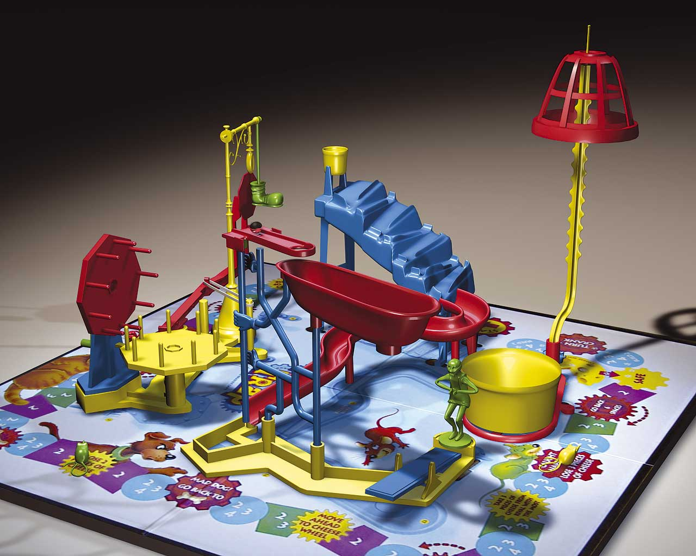
2. Automate Everything
33% more configuration management
27% more testing
30% more deployments
27% more change approval processes
Reference: https://puppet.com/resources/whitepaper/state-of-devops-report

Slide 22
3. Embrace DevOps Practices
Principles
Iterative
Incremental
Continuous
Automated
Self-service
Collaborative
Holistic
Practices
Self-service configuration
Automated provisioning
Continuous build
Continuous integration
Continuous delivery
Automated release management
Incremental testing

Slide 23

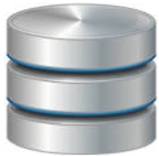
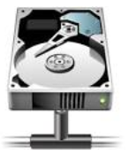

4. Loosely Coupled Architectures
Tightly Coupled Architecture
Loosely Coupled Architecture
APP
APP
APP
APP
APP
APP
Service Oriented Architecture
SQL
FILE
SERVICE
SQL
FILE
SERVICE

Slide 24
5. Lean Product Management
Build, Measure, Learn…Repeat
Minimum Viable Product
Minimum Viable Specs
Developer Collaboration
Feature Flags
Automated Testing

Slide 25
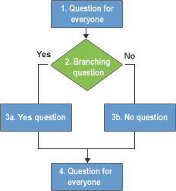
6. Branch Less
Merging code into trunk on a daily basis
Having branches or forks with very short lifetimes (less than a day)
Having fewer than three active branches.
Figure 1.3 Unnecessary Image, Just like Branching
*as measured by productivity, profitability, and market share
Reference: https://puppet.com/resources/whitepaper/state-of-devops-report

Slide 26

7. Get Results
21% less time on unplanned work and rework
44% more time on new work
50% less time remediating security issues
*as measured by productivity, profitability, and market share
Reference: https://puppet.com/resources/whitepaper/state-of-devops-report

Slide 27
High vs. Low Performance* Organizations
Category | High | Low
Build frequency | On demand | 1 week – 1 month
Code to production | Less than 1 hour | 1 week – 1 month
Downtime recovery | Less than 1 hour | 1 day – 1 week
Deploying defects | 0-15% | 31-45%
*as measured by productivity, profitability, and market share
Reference: https://puppet.com/resources/whitepaper/state-of-devops-report

Slide 28

DevOps for COTS
In many cases, it’s far cheaper to modify your business processes, and use your off-the-shelf software as close to its out-of-the-box state as possible.
Translated: Align closely to Dynamics way of doing things instead of custom development.
Reference: https://puppet.com/resources/whitepaper/state-of-devops-report

Slide 29
Benefits to Continuous Delivery (CD)
Accelerated Time to Market: Deliver business value to customers more quickly. This capability helps the company stay a step ahead of the competition.
Building the Right Product: Fast feedback loop building only what’s needed.
Improved Productivity and Efficiency: Significant time savings using automation.
Reliable Releases: The risks associated with a release have significantly decreased, and the release process has become more reliable. With more frequent releases, the number of code changes in each release decreases. This makes finding and fixing any problems that do occur easier, reducing the time in which they have an impact.
Improved Product Quality: The number of open bugs and production incidents has decreased significantly.
Improved Customer Satisfaction: A higher level of customer satisfaction is achieved.

Slide 30
Continuous Obstacles For Some
Freeze Periods: Some customers do not want continuous updates to their systems. This is especially true at the critical stages in their operations.
Regulatory: In some domains, such as telecom and medical, regulations require extensive testing before new versions are allowed to enter the operations phase.
Lack of test automation: Lack of test automation leads to lack developer confidence and can prevent using continuous delivery.
Differences in environments: Different environments used in development, testing and production can result in undetected issues slipping to the production environment.
Needing Human Verification: Not all quality attributes can be verified with automation. These attributes require humans in the loop, slowing down the delivery pipeline.

Slide 31
Setup For Success

Slide 32
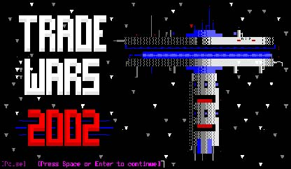
Dynamics 365 Hello World in Production
Love what you do
Do the hard stuff first
Overcome challenges and GROW
Learn your environment
Harness your creative energy
Deliver early and often
During the height of its popularity in the early 1990s, Trade Wars was the preeminent BBS door game, played by thriving tens of thousands of users around the world who would dial up with phone modems into the night after everyone had gone to sleep.

Slide 33
Are You Setup For Success?
Metric | Success | No Success
Team member’s energy level | High | Low
Effective Meetings (Agenda, On Time, Tasks, Names, Dates) | Yes | No
Is Delivering value everyone’s job? | Yes | No
Are there consequences for failure? | Yes | No
Requirements | Real Users | Proxies
Facilities | War Room | Cubes
Infrastructure/Tools/Processes | Working | Work Arounds
Production Deploy | Working | Waiting
Collaboration tools | Concurrent | Sequential

Slide 34
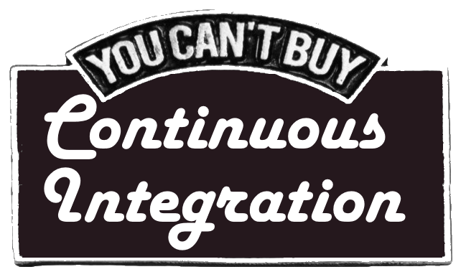
Building Blocks for CI / CD
People & Culture
Process & Practices
Tools & Technology
Change is good
Leadership understands the costs and benefits Be flexible and open minded
Give it time to work
Change is opportunity not a threat.
Company has your back even if things don’t go smoothly
Incorporate DEVs early with BAs to validate requirements and proposed solutions
Invest in test cases for long term gains.
A failed test is a positive result. The earlier you find issues, the faster you can resolve them.
Don’t punish but reward good performance.
Don’t blame or pick on employees for occasionally breaking the build.
Story / Requirements Management
Visual Studio
XrmToolbox
Ribbon Workbench
XrmToolkit
Source Control
Build Server
Wiki
Static Code Analysis
Test Scenarios
Defect Management
Unit Testing
Automated UI Testing
Load Testing

Slide 35
Team Development Models

Slide 36
Organizing your team to develop solutions
Single organization: One master solution - Multiple developers can work on a single organization; however, they have to be careful to work on separate components. This is easier when any prerequisite managed solutions (shared libraries) are installed first.
Single organization: Multiple developer solutions + master solution - In a single organization, you can create separate unmanaged solutions for each developer. Each solution contains a sub set of a master solution. Each solution component exists in only one unmanaged solution. Developers do not add existing solution components to the unmanaged solutions assigned to them. This provides a clear separation of components that are being modified. You do not have to merge changes because each developer’s solution contains a reference to components that are contained in the master solution.
One organization per developer - Each developer can work on their own organization. To check their changes into Microsoft Dynamics 365, they must export their solution as an unmanaged solution. The solution from each developer’s organization is then imported into a master solution. Use the master solution to export the managed solution.
https://msdn.microsoft.com/en-us/library/gg328392.aspx

Slide 37
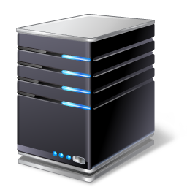

Single organization: One master solution
TFVC
BUILD AGENT
Release
DEV
SIT
SAT
UAT
PROD
Notes:
Multiple developers can work on a single organization; however, they have to be careful to work on separate components. This is easier when any prerequisite managed solutions (shared libraries) are installed first.

Slide 38
Single organization: Multiple DEV solutions overlay components single master solution
TFVC
BUILD AGENT
Release
DEV
SIT
SAT
UAT
PROD
Notes:
Multiple developers can work on a single organization; however, they have to be careful to work on separate components. This is easier when any prerequisite managed solutions (shared libraries) are installed first.

Slide 39
Multi-org imported into master org
TFVC
DEV MASTER
BUILD AGENT
Release
DEV
DEV
DEV
SIT
SAT
UAT
PROD
Notes:
Multiple developers can work on a single organization; however, they have to be careful to work on separate components. This is easier when any prerequisite managed solutions (shared libraries) are installed first.

Slide 40

Single Org: One master solution
No two versions
Merging is unavoidable
Cooperation Required
Break Early, Fix Early

Slide 41
DEMO VSTS Environments
Release
TFVC
Get Latest CRM Solution / Code
Code Built From Source
BUILD AGENT
Static Code Analysis
Unit Tests
Rebuild Plugins
PROD
Solution Deployed
Data Deployed
Automated UI Testing
DEV
SIT

Slide 42
Visual Studio Team Services

Slide 43
VSTS DEMO

Slide 44
VSTS Build Agent

Slide 45
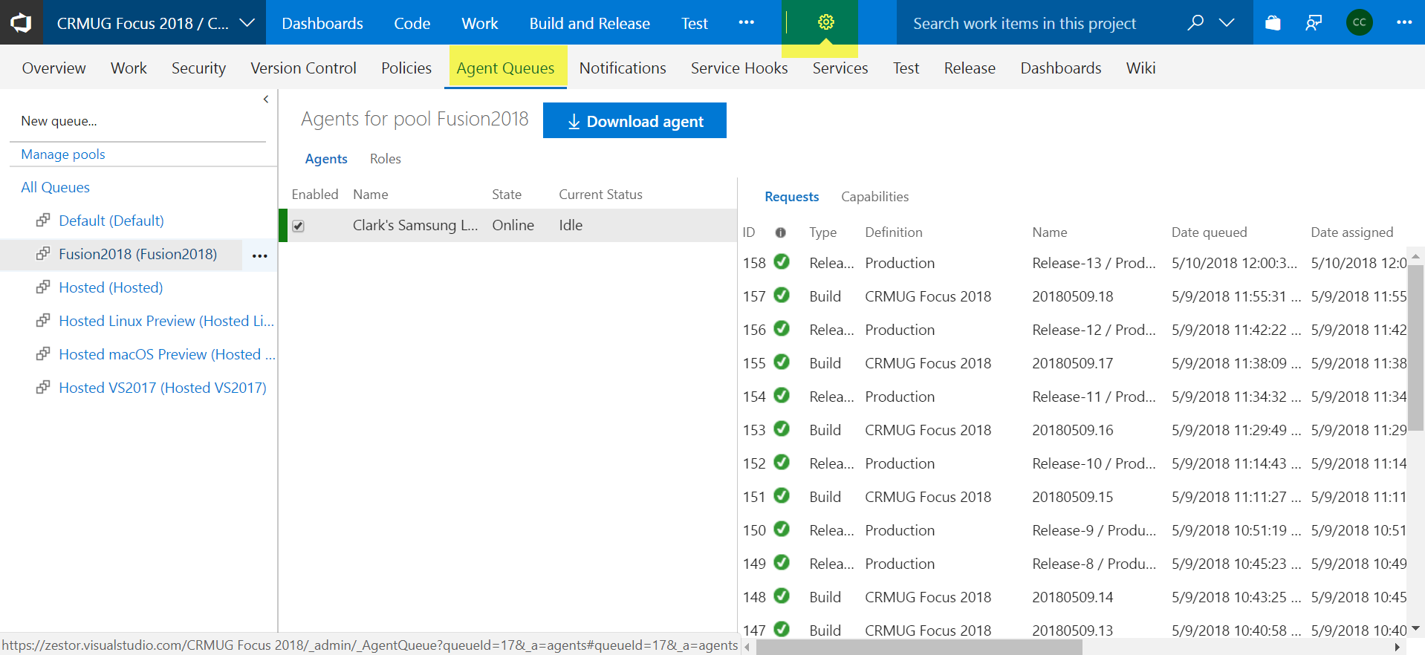
VSTS Build Agent Queues

Slide 46
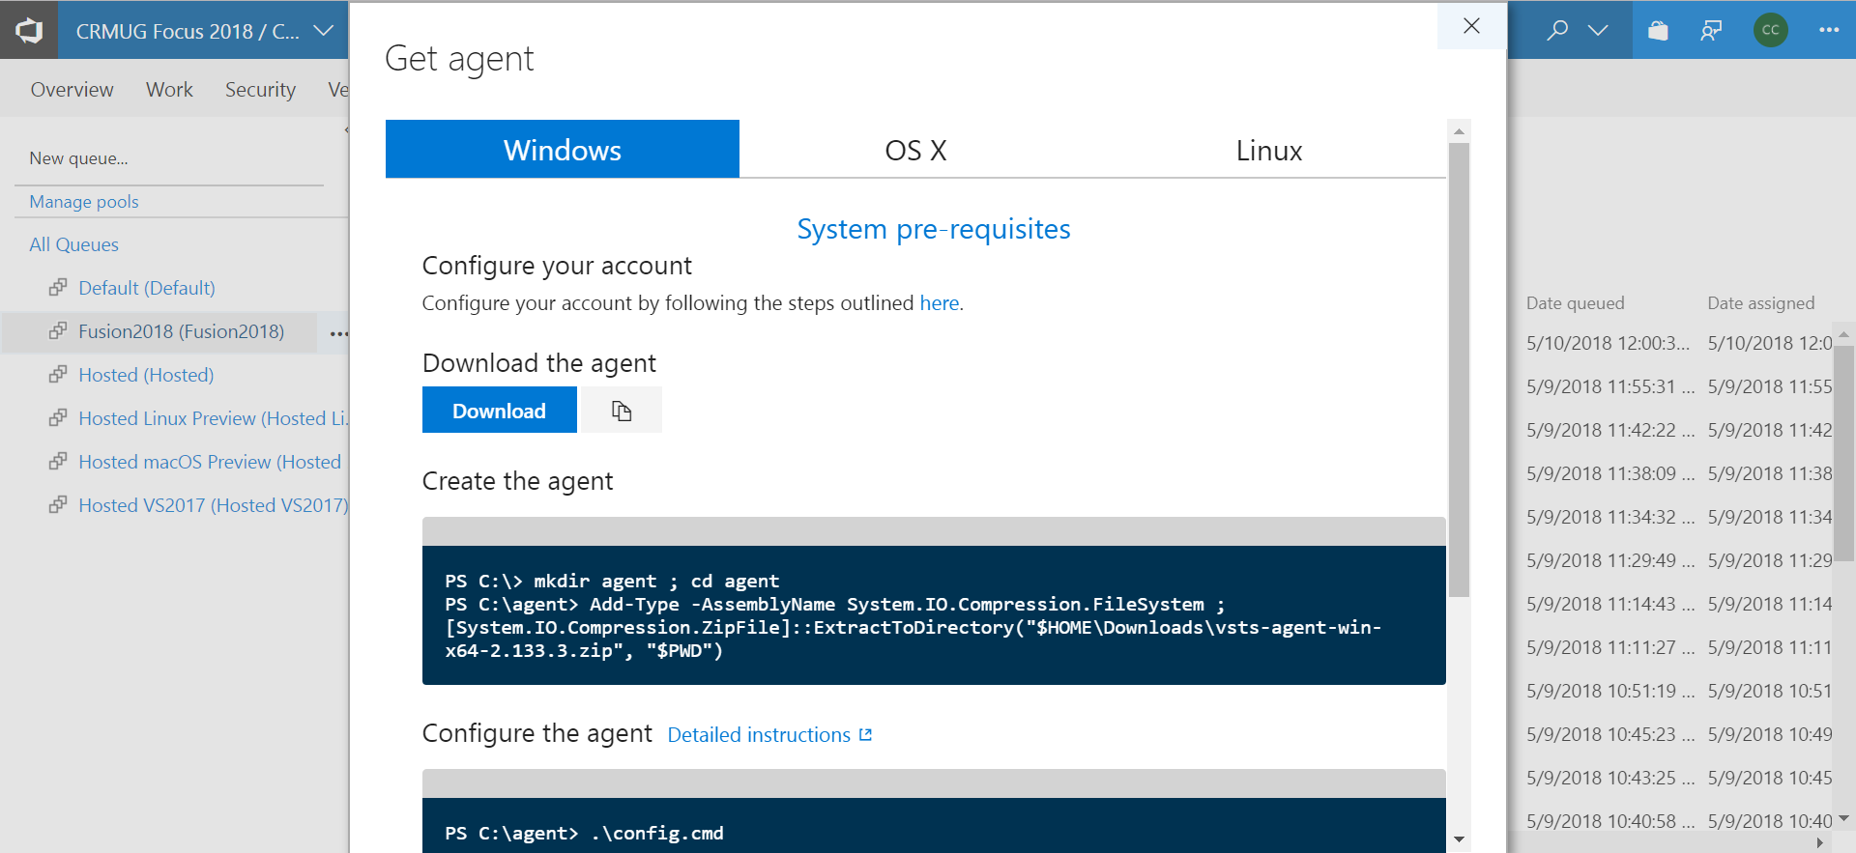
Download VSTS Build Agent

Slide 47
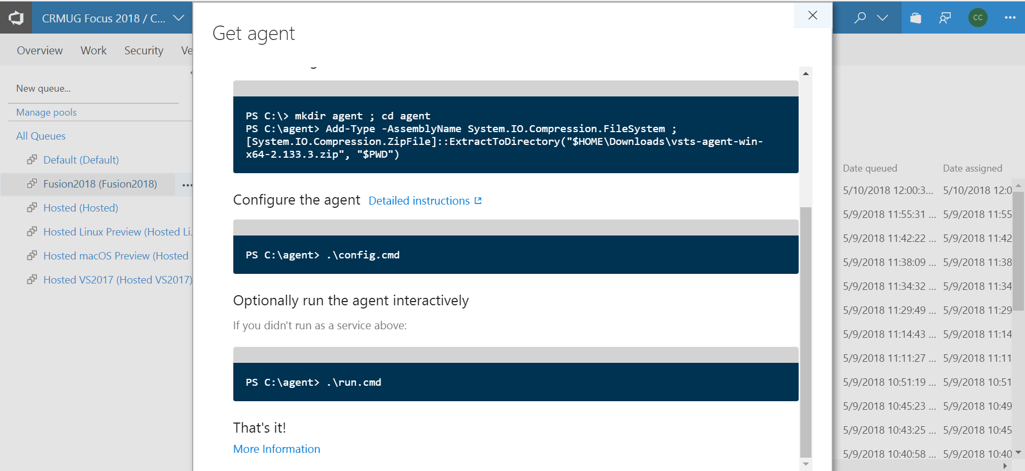
VSTS Build Agent Configure and Run

Slide 48
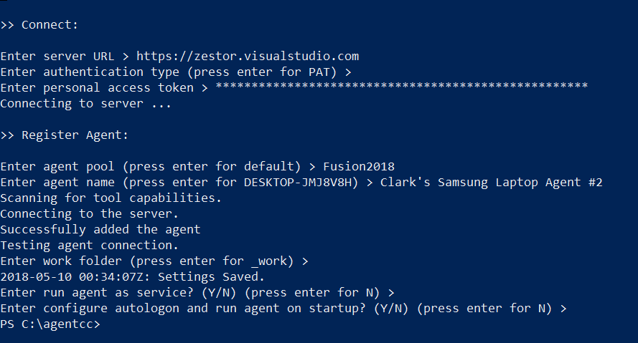
VSTS Build Agent .\config.cmd

Slide 49
Kick Off Build – Developer

Slide 50
Visual Studio Solutions Overview
Visual Studio Solution | Description
CRM | Latest CRM solution, and all previous CRM solutions
EasyRepo-releases-v9.0 | Automated UI tests
Plugins | CRM plugins

Slide 51
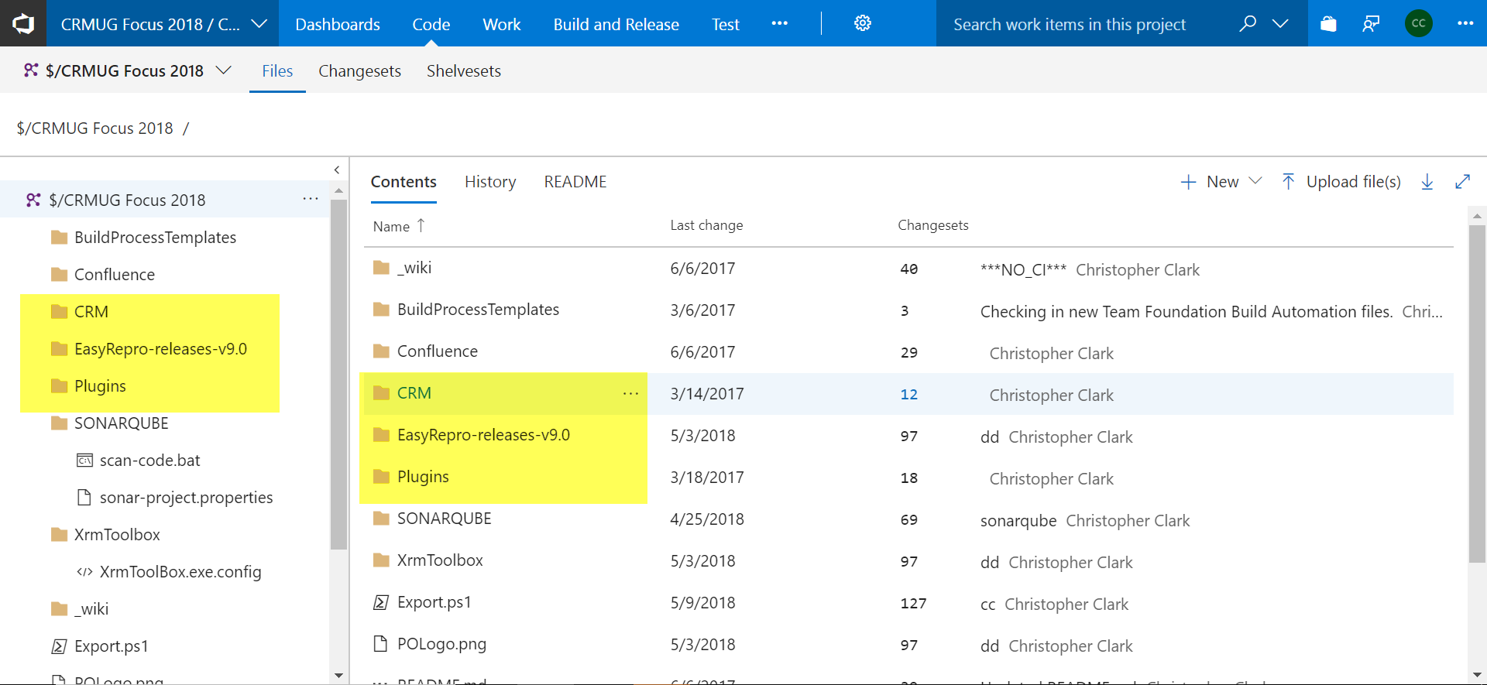
Source Control in VSTS

Slide 52
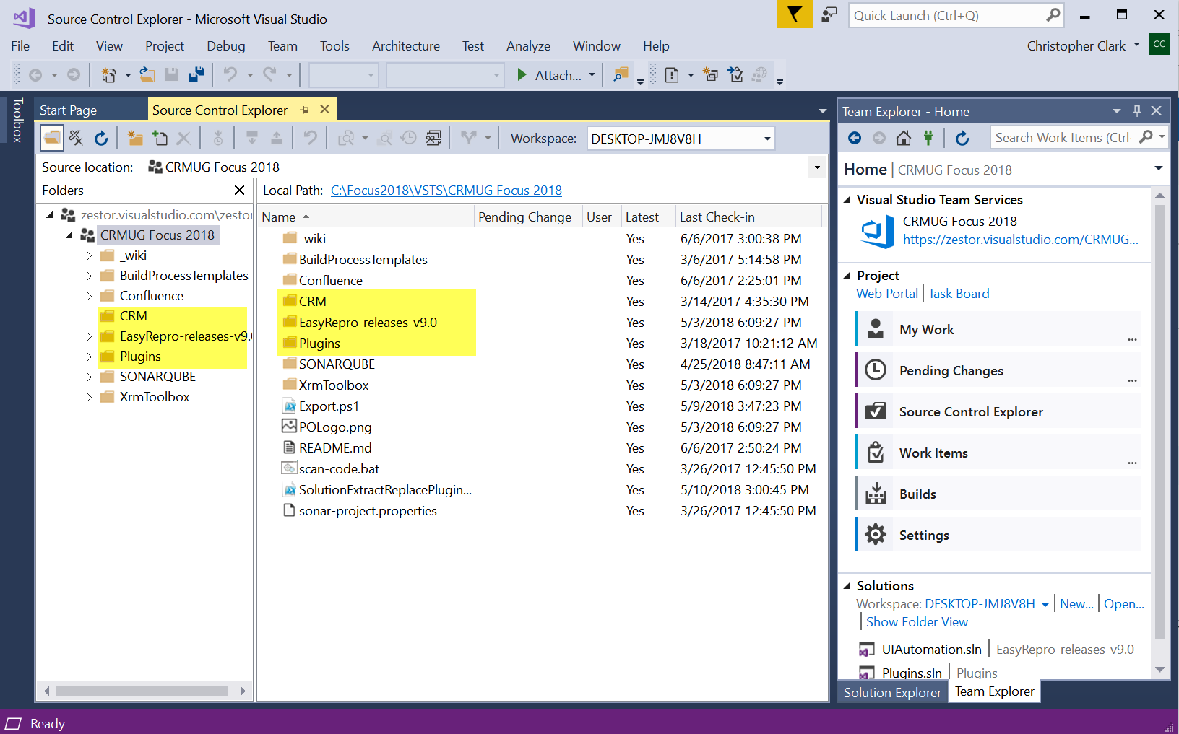
Source Control in Visual Studio

Slide 53
Export Solution

Slide 54
Short Intro to Dynamics 365 (SDK)
Web API, Org Service – Create, Read, Update, Delete
Configuration Migration Tool – Move Data
Client Javascript API – Form customizations
Solution Packager – Import/Export CRM solutions
Package Deployer – Deploy solutions, data, custom code
Plugin Registration Tool – Register plugins
PowerShell Tooling – Management, Connector, Packages
… and more
https://www.microsoft.com/en-us/download/details.aspx?id=50032

Slide 55
Export Solution
Connect to Domain
Look for CRM Solution
Increment CRM Solution Version 1.0.0.X
Export Unmanaged Solution to ZIP
https://www.microsoft.com/en-us/download/details.aspx?id=50032

Slide 56
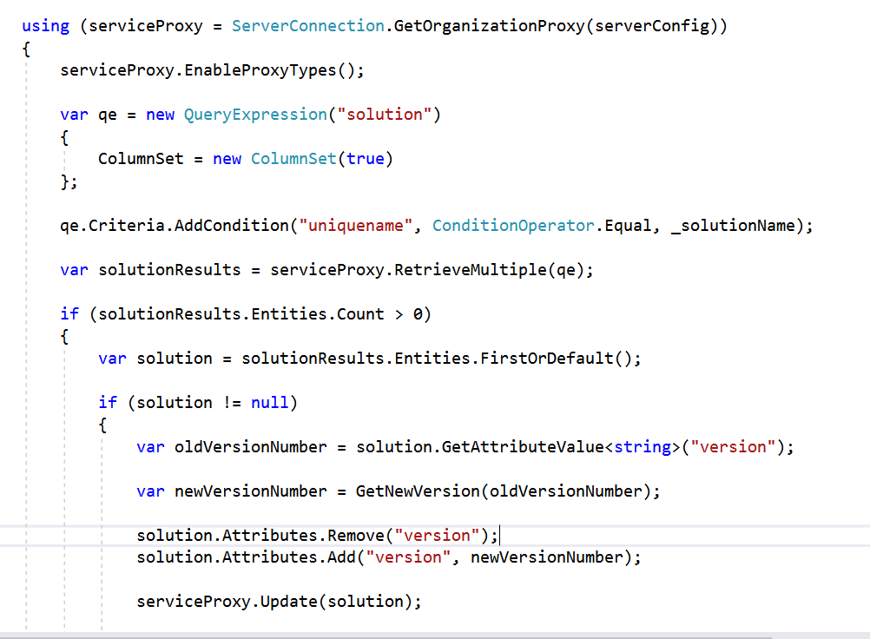
Update Dev Solution Entity “version”

Slide 57
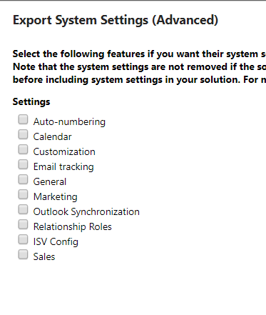
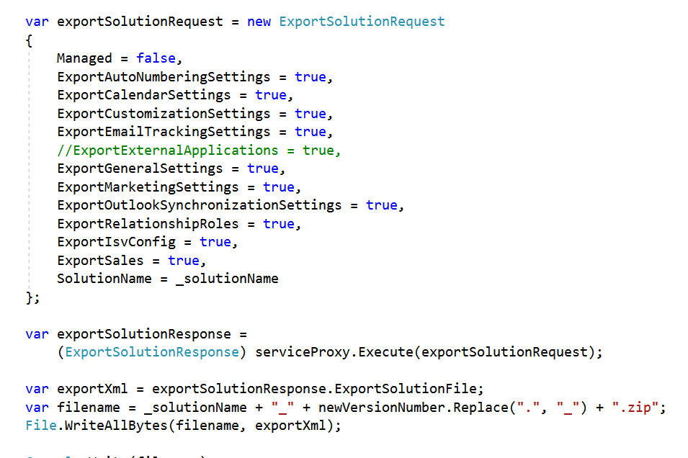
ExportSolutionRequest
https://msdn.microsoft.com/en-us/library/microsoft.crm.sdk.messages.exportsolutionrequest.aspx

Slide 58
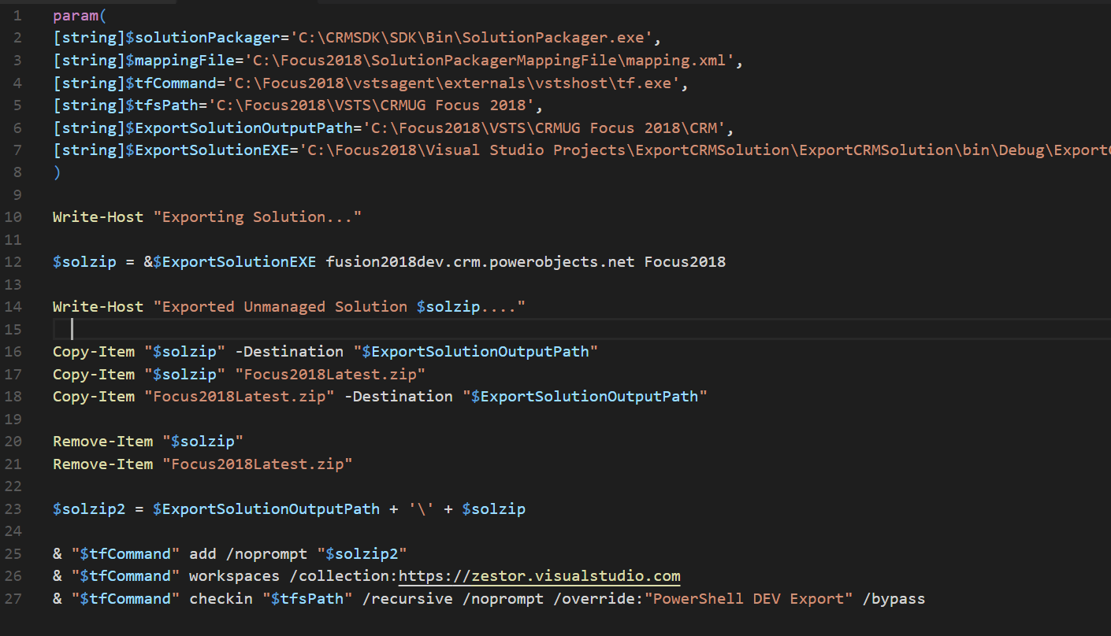
Solution Export Powershell Script

Slide 59
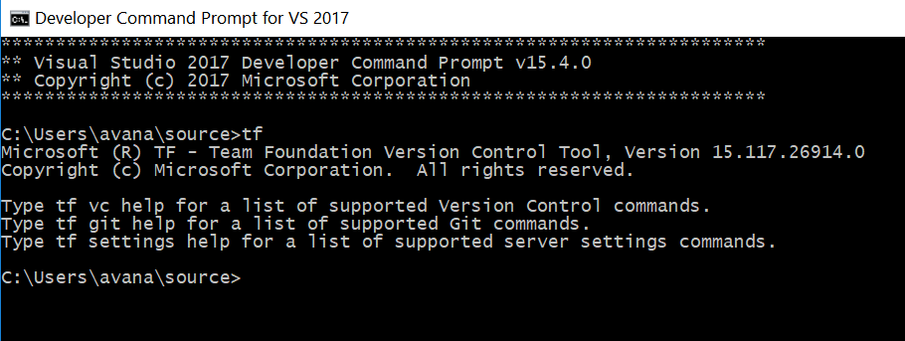
Command Line: Check In Code
C:\> tf workspaces /collection:https://zestor.visualstudio.com
Displays information about workspaces in the system and updates cached information about a user name or computer name change on Team Foundation Server.
C:\> tf add /noprompt Focus2018_1_0_0_105.zip
Adds new files and folders from a local file system location to Team Foundation version control.
C:\> tf vc checkin C:\Focus2018\VSTS\CRMUG Focus 2018\CRM /recursive /noprompt /comment:"PowerShell DEV Export"
Commits pending changes in the current workspace to Team Foundation version control.

Slide 60
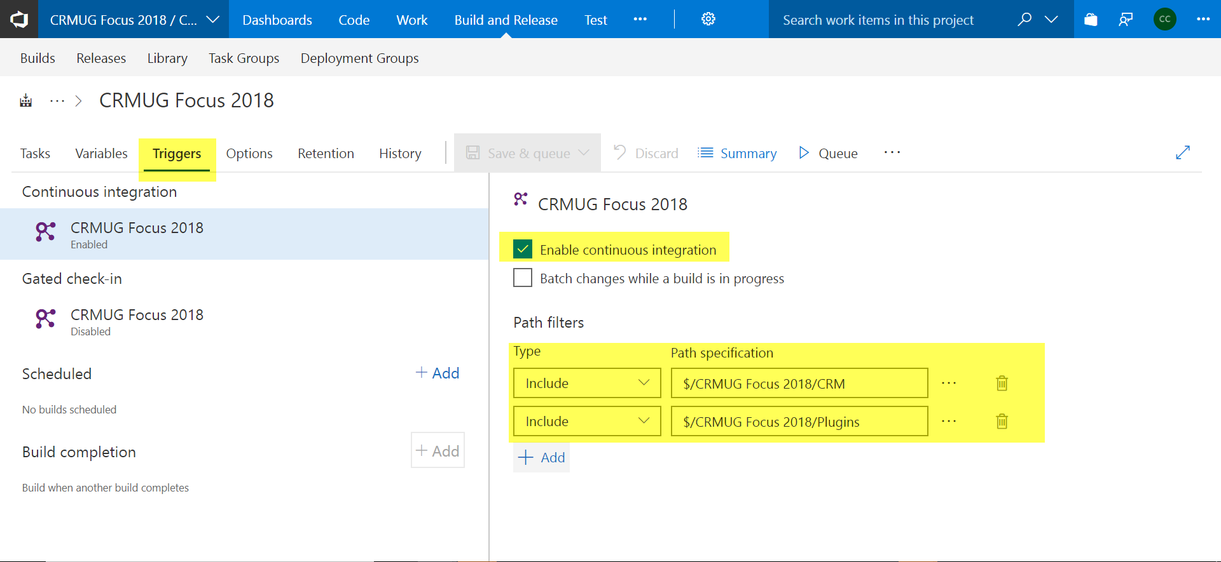
After We Check In, Trigger the Build

Slide 61
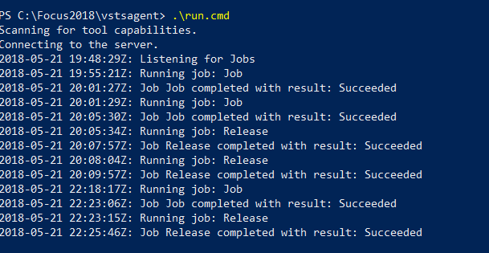
Check In Triggers Build

Slide 62
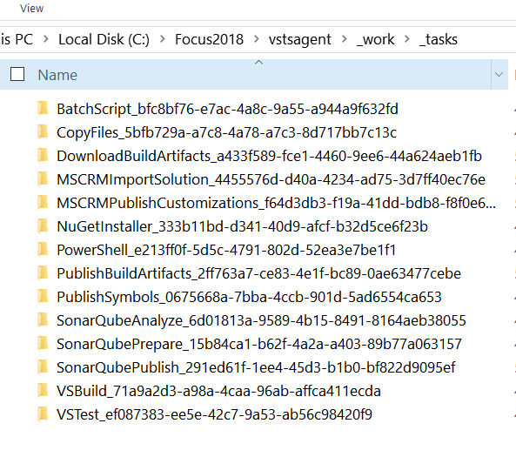
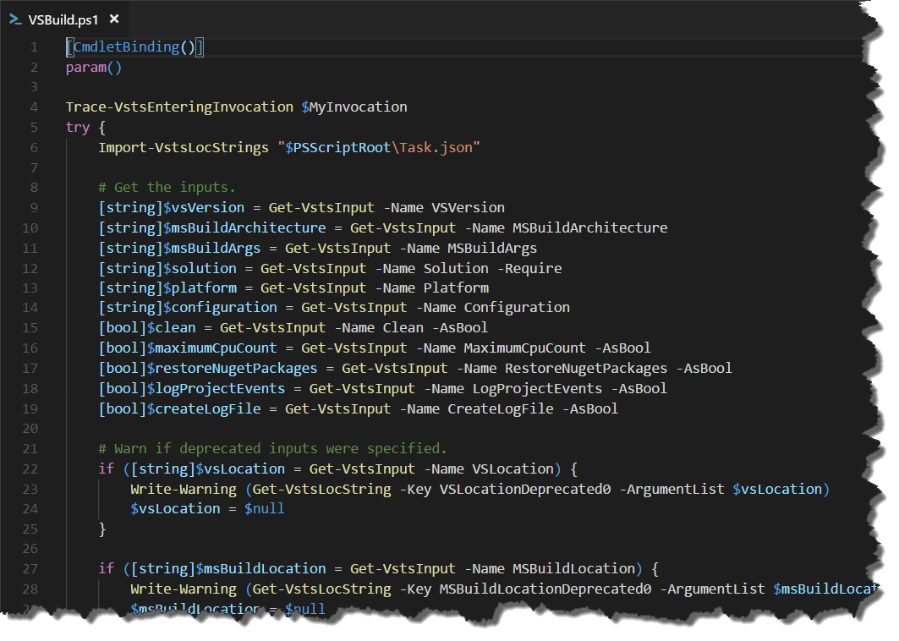
What is a Build Agent Task?
Javascript
TypeScript
Coffee
JSON
Markdown
HTML
BAT
CMD
EXE
DLL
JAR

Slide 63
NEW BUILD STARTED ON BUILD AGENT
Get Source Code from TFVC
NuGet Restore Packages
Build Solutions
SonarQube Static Code Analysis
Unit Tests
Update Solution plugins from source control
CRM Solution Import into SIT Environment
Cucumber / Selenium Automated UI Testing

Slide 64
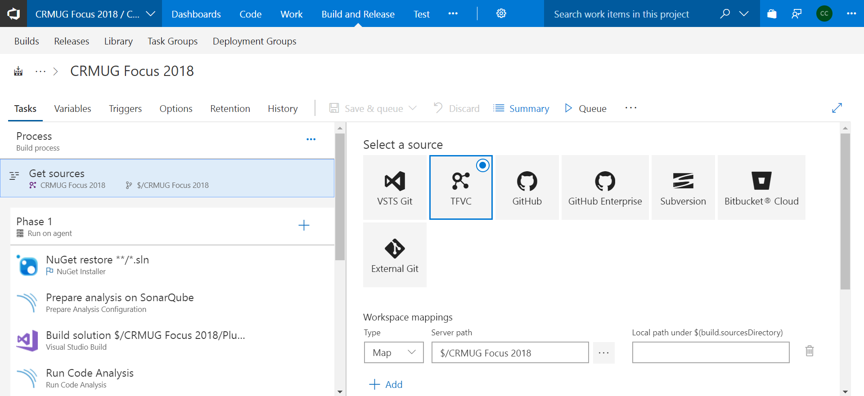
Get Sources Build Task

Slide 65
Get Sources Agent Build Task
2018-05-09T23:55:37.8575739Z ##[section]Starting: Get Sources
2018-05-09T23:55:37.8953095Z Prepending Path environment variable with directory containing 'tf.exe'.
2018-05-09T23:55:37.8960515Z Setting environment variable TFVC_BUILDAGENT_POLICYPATH
2018-05-09T23:55:37.8961551Z Querying workspace information.
2018-05-09T23:55:39.7354447Z ##[command]tf vc undo /recursive C:\Focus2018\vstsagent\_work\1\s /loginType:OAuth /login:.,******** /noprompt
2018-05-09T23:55:40.3304182Z CRM:
2018-05-09T23:55:40.3308086Z Undoing edit: Focus2018Latest.zip
2018-05-09T23:55:40.4264192Z ##[command]tf vc get /version:138 /recursive /overwrite C:\Focus2018\vstsagent\_work\1\s /loginType:OAuth /login:.,******** /noprompt
2018-05-09T23:55:41.7458712Z C:\Focus2018\vstsagent\_work\1\s\CRM:
2018-05-09T23:55:41.7471720Z Getting Focus2018_1_0_0_97.zip
2018-05-09T23:55:41.7581406Z Replacing Focus2018Latest.zip
2018-05-09T23:55:42.4567452Z ##[section]Finishing: Get Sources

Slide 66
Get Sources From Command Line
Microsoft (R) TF - Team Foundation Version Control Tool, Version 15.117.26914.0
C:\>tf workspaces /collection:https://zestor.visualstudio.com
Displays information about workspaces in the system and updates cached information about a user name or computer name change on Team Foundation Server.
C:\> tf vc undo /recursive . /noprompt
Removes pending changes from a workspace.
C:\> tf vc get /version:138 /recursive /overwrite . /noprompt
Retrieves a copy of files from Team Foundation Server to the workspace and creates folders on disk to contain it.

Slide 67
NEW BUILD STARTED ON BUILD AGENT
Get Source Code from TFVC
NuGet Restore Packages
Build Solutions
SonarQube Static Code Analysis
Unit Tests
Update Solution plugins from source control
CRM Solution Import into SIT Environment
Cucumber / Selenium Automated UI Testing

Slide 68
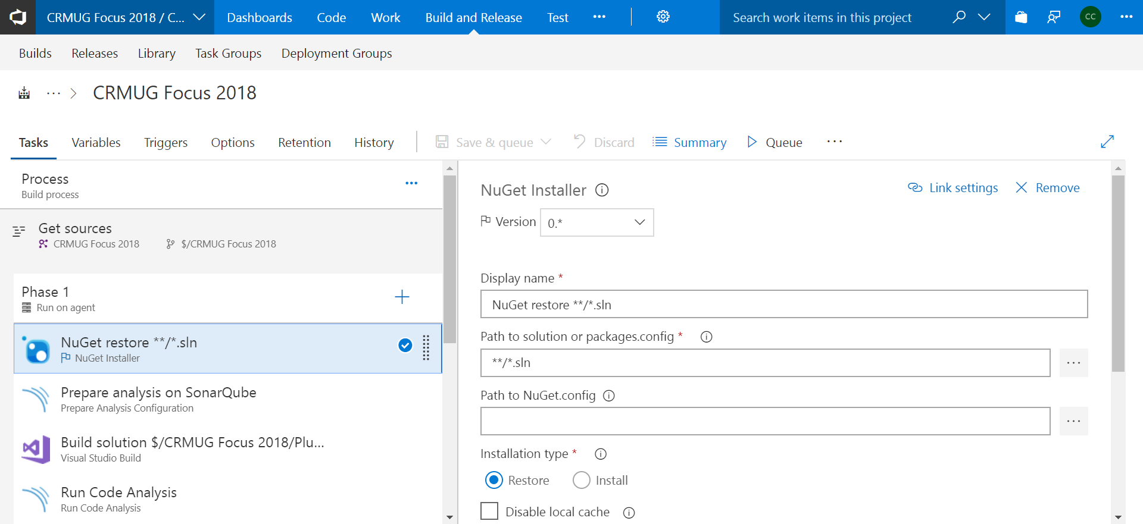
NuGet Restore Build Task

Slide 69
NuGet Restore Build Task
2018-05-09T23:55:42.4662218Z ##[section]Starting: NuGet restore **/*.sln
2018-05-09T23:55:42.4808864Z ==============================================================================
2018-05-09T23:55:42.4809114Z Task : NuGet Installer
2018-05-09T23:55:42.4809305Z Description : Installs or restores missing NuGet packages
2018-05-09T23:55:42.4809492Z Version : 0.2.31
2018-05-09T23:55:42.4809661Z Author : Microsoft Corporation
2018-05-09T23:55:42.4809862Z Help : [More Information](https://go.microsoft.com/fwlink/?LinkID=613747)
2018-05-09T23:55:42.4810084Z ==============================================================================
2018-05-09T23:55:43.9791766Z To connect to NuGet feeds hosted in your Team Services account/TFS project collection on this build agent, edit your build definition to choose a higher version of nuget or specify a path to a NuGet.config containing the package sources you wish to use.
2018-05-09T23:55:43.9814153Z [command]C:\Focus2018\vstsagent\_work\_tasks\NuGetInstaller_333b11bd-d341-40d9-afcf-b32d5ce6f23b\0.2.31\node_modules\nuget-task-common\NuGet\3.3.0\NuGet.exe restore -NonInteractive C:\Focus2018\vstsagent\_work\1\s\EasyRepro-releases-v9.0\UIAutomation.sln
2018-05-09T23:55:44.2927249Z MSBuild auto-detection: using msbuild version '4.0' from 'C:\Windows\Microsoft.NET\Framework\v4.0.30319'.
2018-05-09T23:55:44.3732943Z All packages listed in packages.config are already installed.
2018-05-09T23:55:44.3916592Z [command]C:\Focus2018\vstsagent\_work\_tasks\NuGetInstaller_333b11bd-d341-40d9-afcf-b32d5ce6f23b\0.2.31\node_modules\nuget-task-common\NuGet\3.3.0\NuGet.exe restore -NonInteractive C:\Focus2018\vstsagent\_work\1\s\Plugins\Plugins.sln
2018-05-09T23:55:44.6898701Z MSBuild auto-detection: using msbuild version '4.0' from 'C:\Windows\Microsoft.NET\Framework\v4.0.30319'.
2018-05-09T23:55:44.7678875Z All packages listed in packages.config are already installed.
2018-05-09T23:55:44.7964908Z ##[section]Finishing: NuGet restore **/*.sln

Slide 70
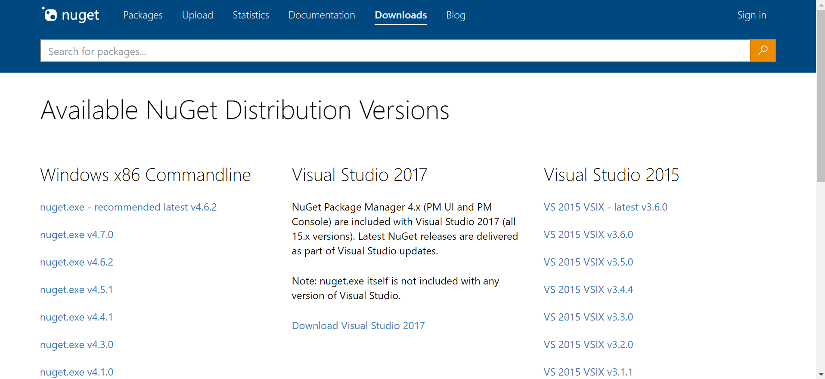
NuGet Command Line
https://www.nuget.org/downloads

Slide 71
NuGet Command Line Restore
NuGet.exe restore –NonInteractive <MySolution>.sln
NuGet.exe restore -NonInteractive C:\Focus2018\vstsagent\_work\1\s\EasyRepro-releases-v9.0\UIAutomation.sln
NuGet.exe restore -NonInteractive C:\Focus2018\vstsagent\_work\1\s\Plugins\Plugins.sln

Slide 72
NEW BUILD STARTED ON BUILD AGENT
Get Source Code from TFVC
NuGet Restore Packages
Build Solutions
SonarQube Static Code Analysis
Unit Tests
Update Solution plugins from source control
CRM Solution Import into SIT Environment
Cucumber / Selenium Automated UI Testing

Slide 73
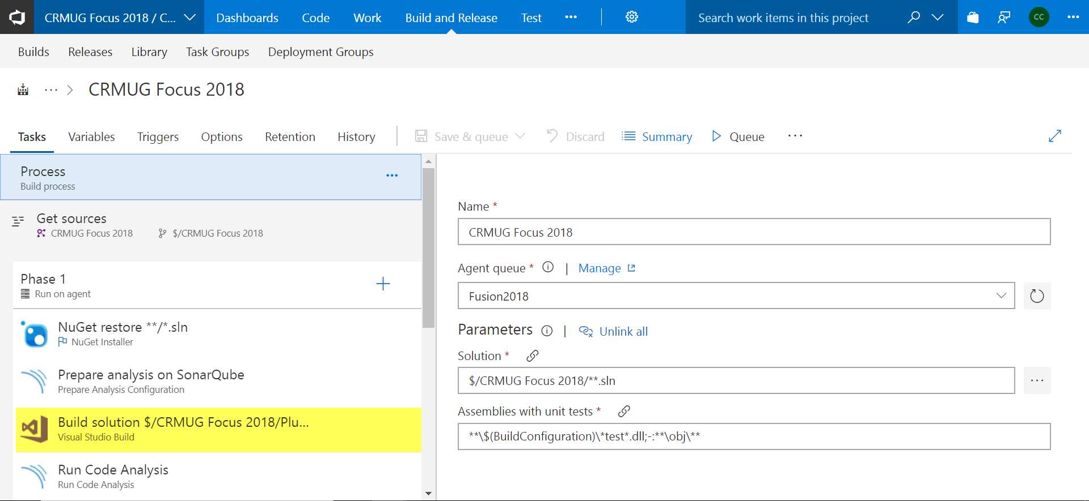
VSTS Build Task

Slide 74
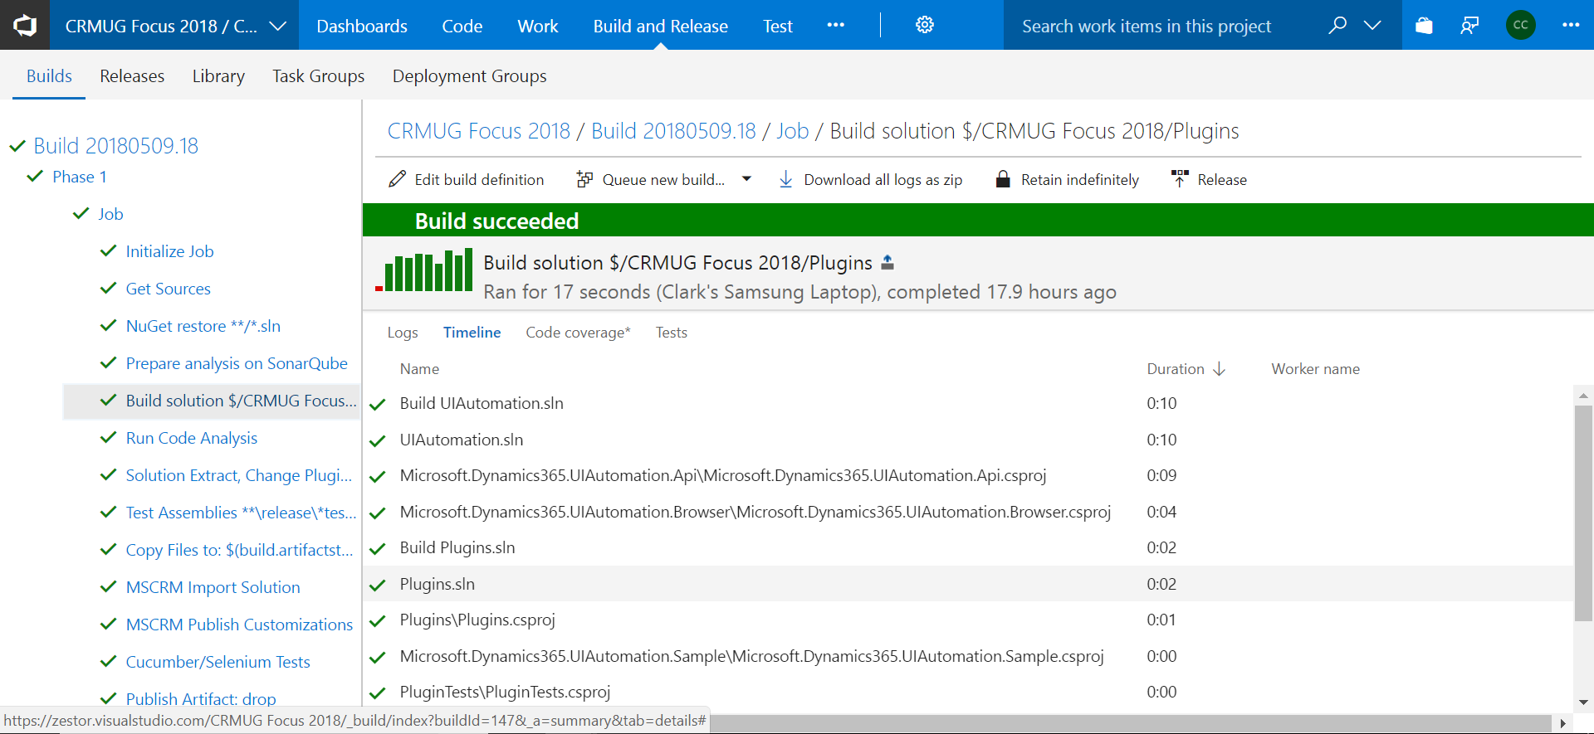
VSTS Build All Projects

Slide 75
Command Line : Build Projects
VSWHERE
vswhere.exe is a single-file, native executable you can download or redistribute with your build and deployment environments to locate Visual Studio or other products installed with the new installer for Visual Studio 2017
https://github.com/Microsoft/vswhere
vswhere.exe -version [15.0,16.0) -latest -format json
MSBUILD
Microsoft Build Engine, better known as MSBuild, is a free and open-source build tool set for managed code as well as native C++ code and was part of .NET Framework.
https://github.com/Microsoft/msbuild
msbuild.exe "EasyRepro-releases-v9.0\UIAutomation.sln“ /nologo /nr:false /p:platform="any cpu" /p:configuration="release"
msbuild.exe “Plugins\Plugins.sln” /nologo /nr:false /p:platform="any cpu" /p:configuration="release"

Slide 76
NEW BUILD STARTED ON BUILD AGENT
Get Source Code from TFVC
NuGet Restore Packages
Build Solutions
SonarQube Static Code Analysis
Unit Tests
Update Solution plugins from source control
CRM Solution Import into SIT Environment
Cucumber / Selenium Automated UI Testing

Slide 77

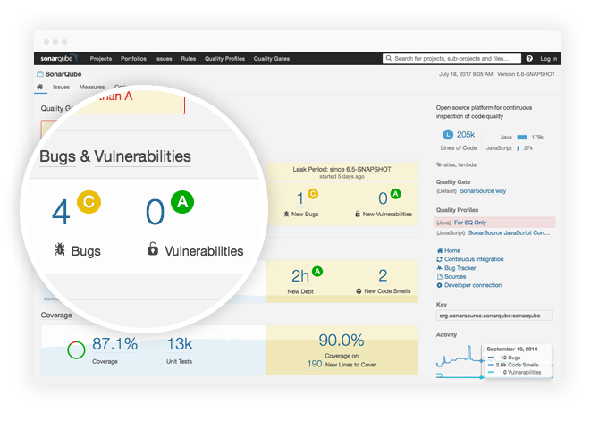
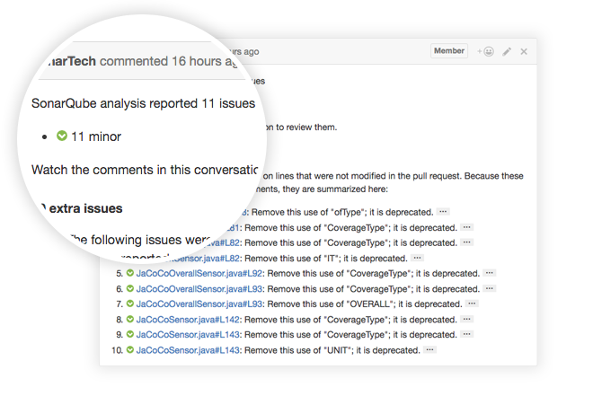
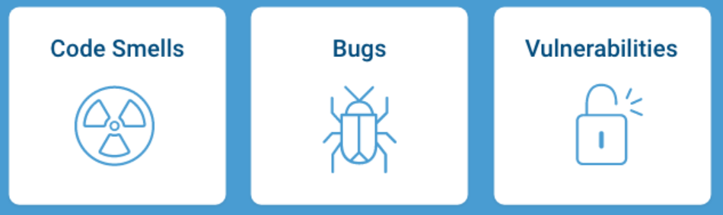
SonarQube – Build Server Analysis
Continuous Code Inspection against your rules
https://www.sonarqube.org/
https://www.sonarsource.com/plans-and-pricing

Slide 78
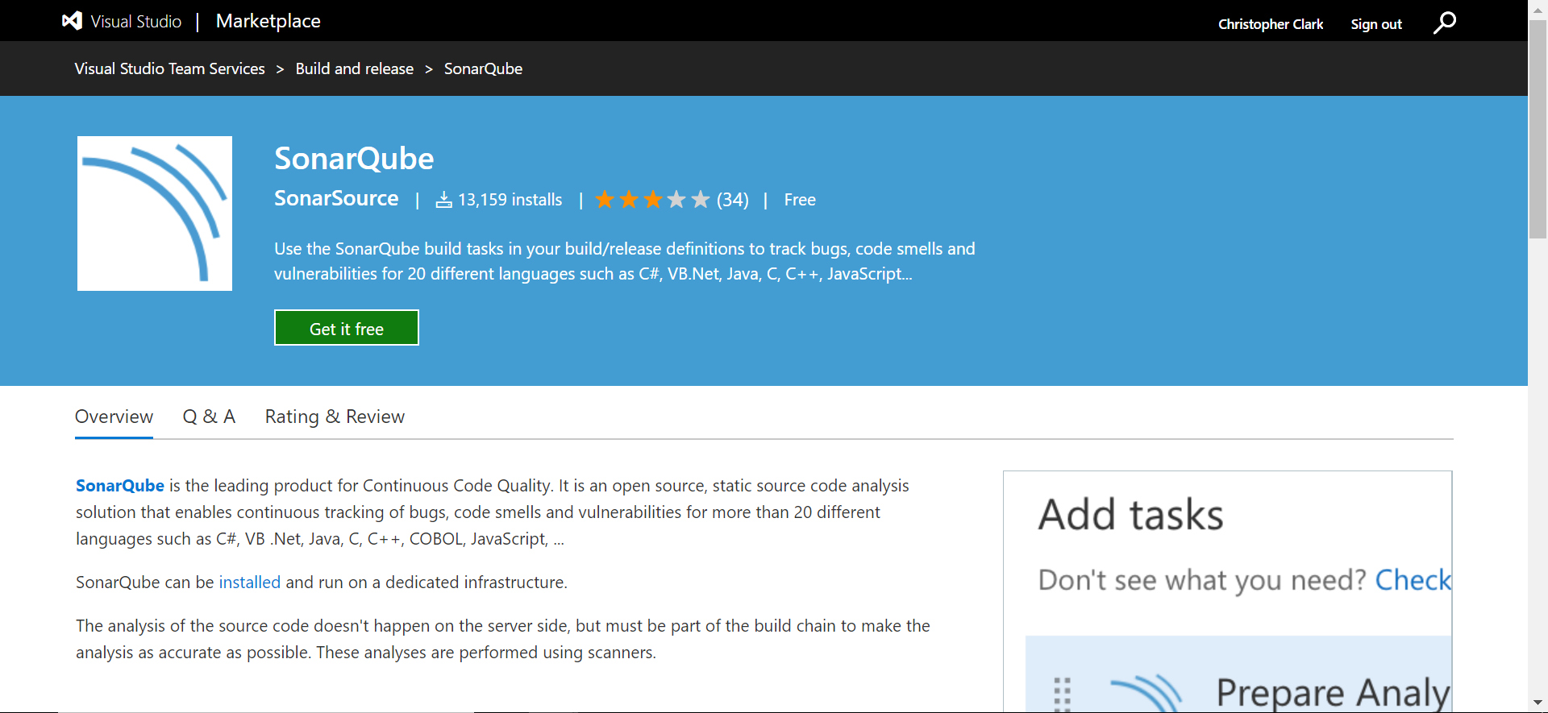
VSTS SonarQube Extension
https://marketplace.visualstudio.com/items?itemName=SonarSource.sonarqube

Slide 79
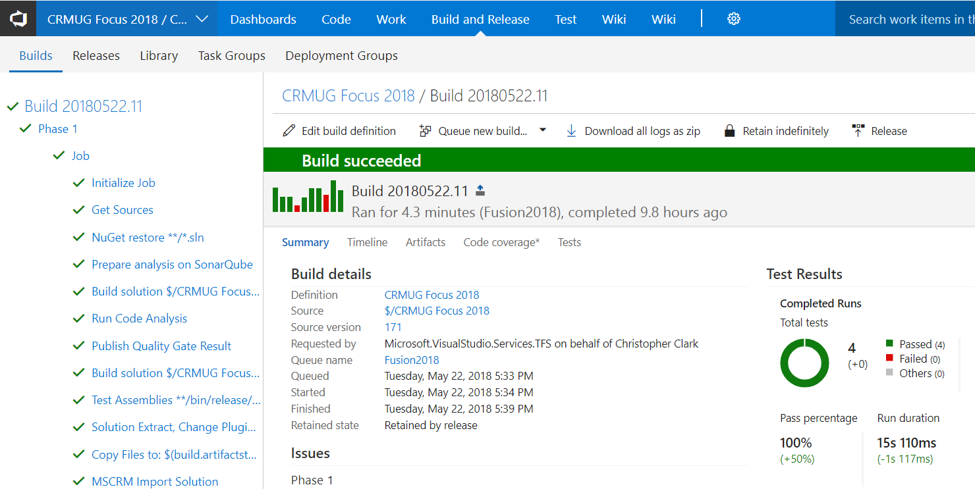
VSTS SonarQube Code Analysis

Slide 80
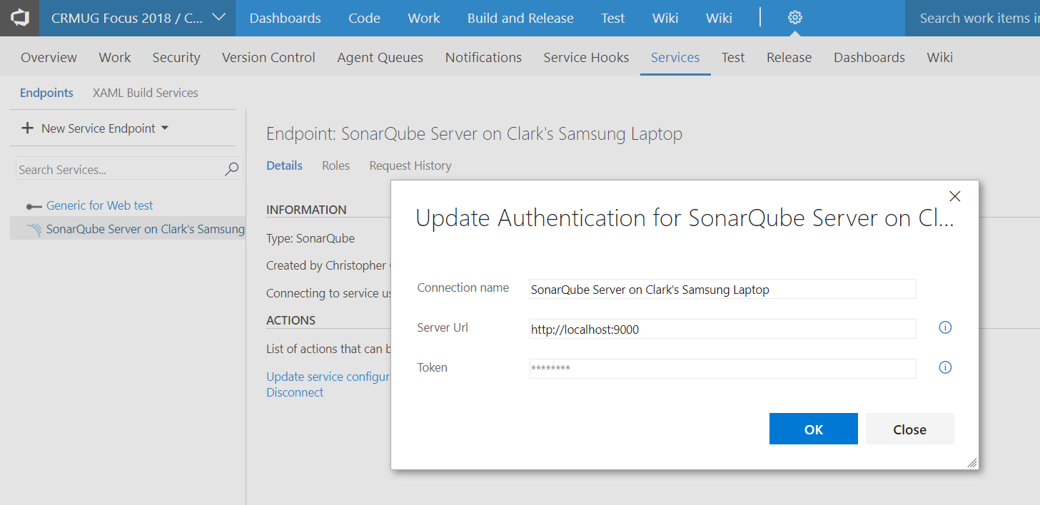
SonarQube Service Endpoint in VSTS

Slide 81
Command Line: SonarQube Begin / End
SonarScanner.MSBuild.exe begin /k:"project-key“
MSBuild.exe /t:Rebuild
SonarScanner.MSBuild.exe end
https://docs.sonarqube.org/display/SCAN/Analyzing+with+SonarQube+Scanner+for+MSBuild

Slide 82
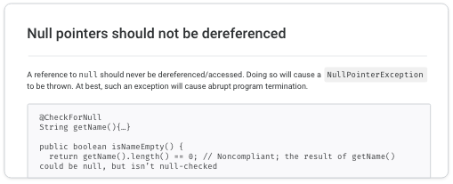
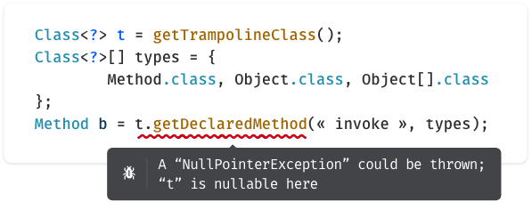
SonarLint – Developer Desktop
On the fly code analysis for Visual Studio and Visual Studio Code
https://www.sonarlint.org/

Slide 83
NEW BUILD STARTED ON BUILD AGENT
Get Source Code from TFVC
NuGet Restore Packages
Build Solutions
SonarQube Static Code Analysis
Unit Tests
Update Solution plugins from source control
CRM Solution Import into SIT Environment
Cucumber / Selenium Automated UI Testing

Slide 84
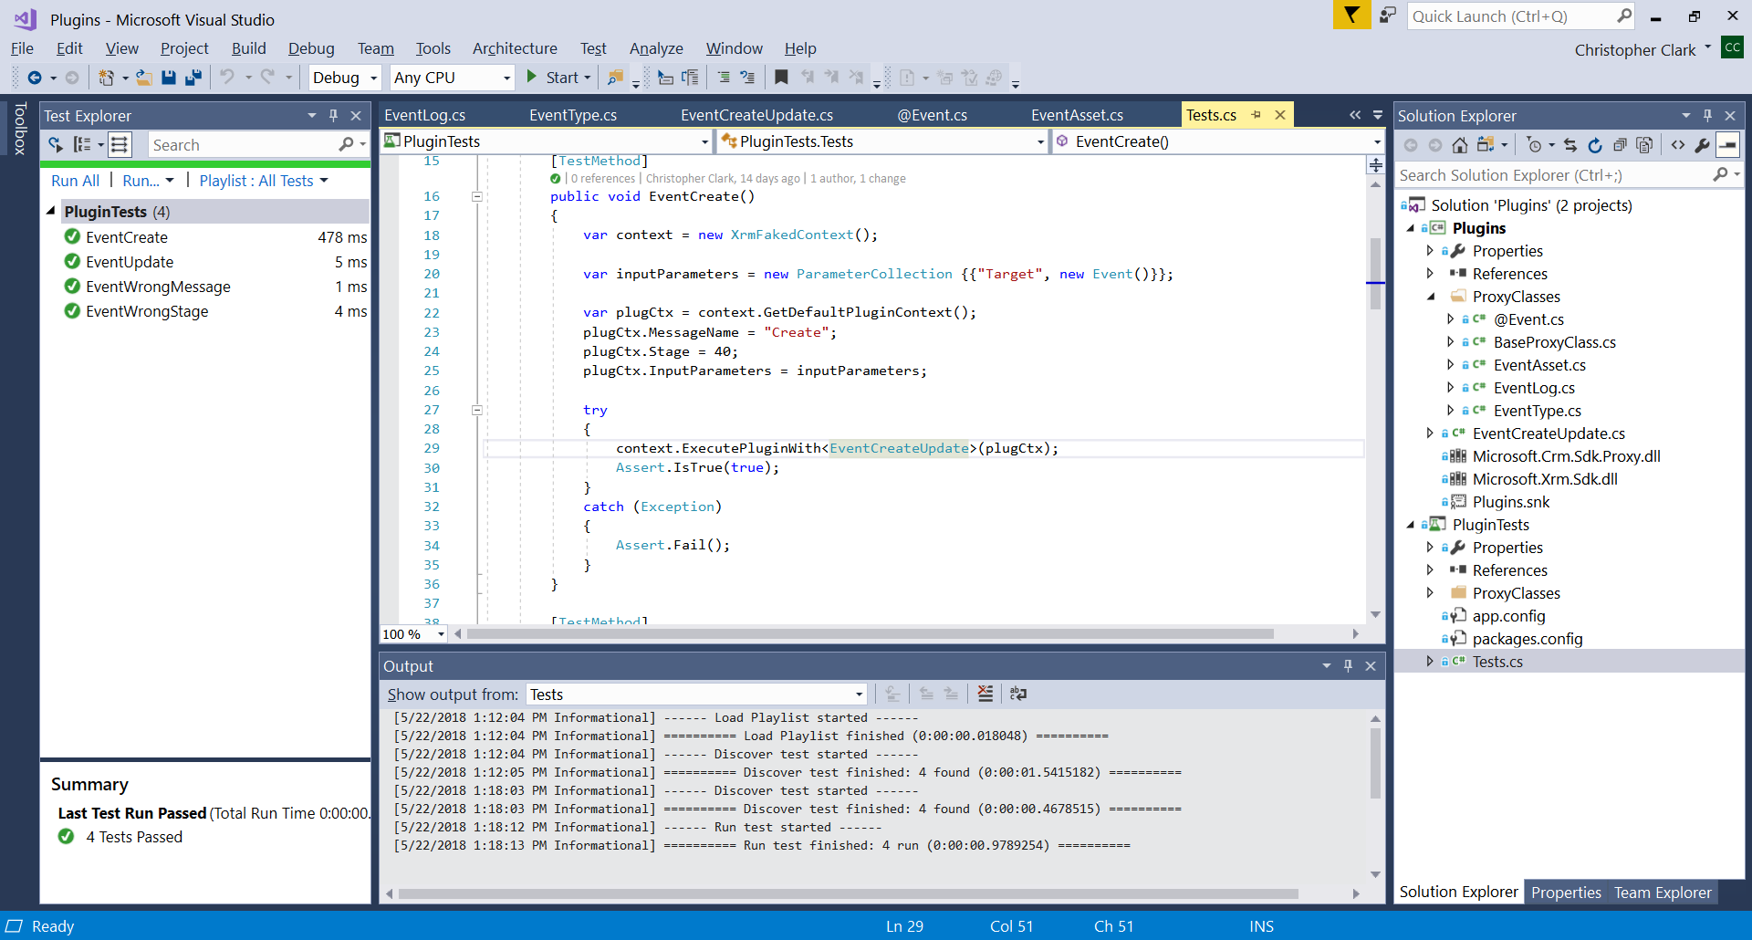
FakeXrmEasy

Slide 85
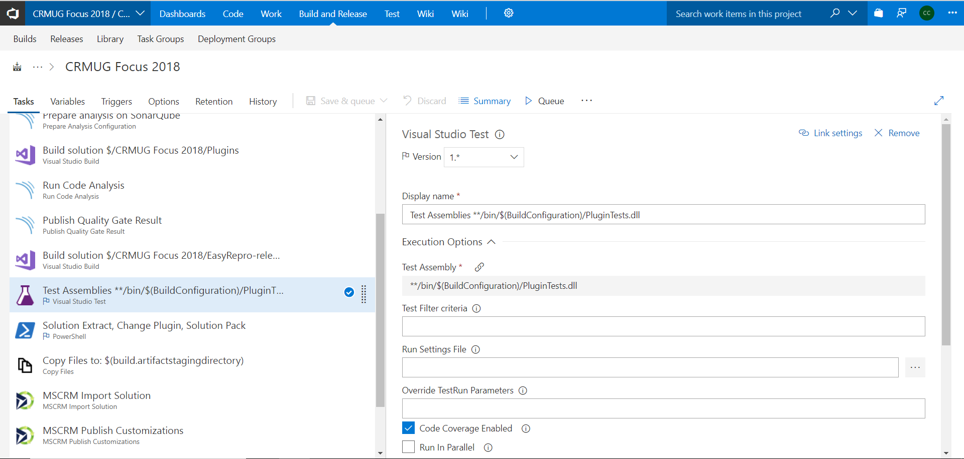
VSTS Unit Testing Task

Slide 86
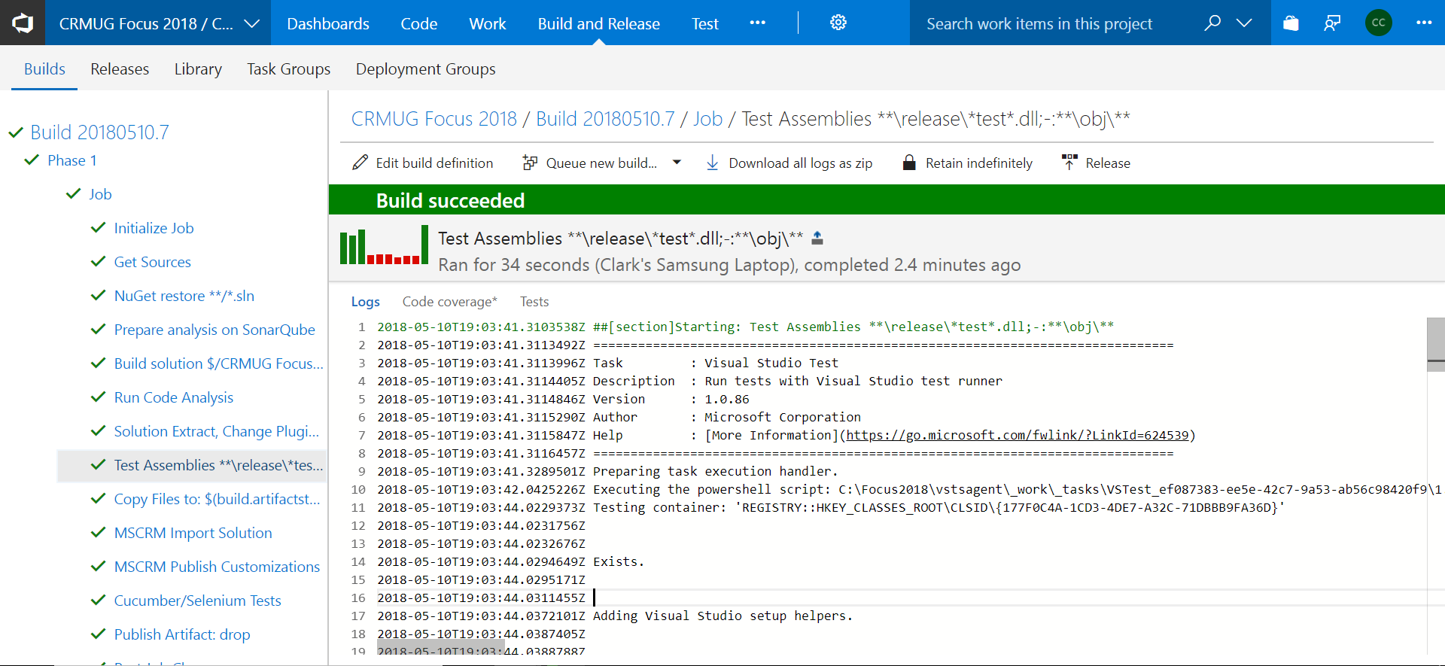
VSTS Unit Testing Task

Slide 87
VSTest.Console.exe command-line options
The usage for vstest.console.exe is:
Vstest.console.exe [TestFileNames] [Options]
The following shows an example of using VSTest.Console.exe from the command line:
Vstest.console.exe myTestProject.dll
The following shows an example of using VSTest.Console.exe from the command line using multiple test files. This is done by separating test file names with spaces:
Vstest.console.exe myTestFile.dll myOtherTestFile.dll
https://msdn.microsoft.com/en-us/library/jj155796.aspx

Slide 88
NEW BUILD STARTED ON BUILD AGENT
Get Source Code from TFVC
NuGet Restore Packages
Build Solutions
SonarQube Static Code Analysis
Unit Tests
Update Solution plugins from source control
CRM Solution Import into SIT Environment
Cucumber / Selenium Automated UI Testing

Slide 89
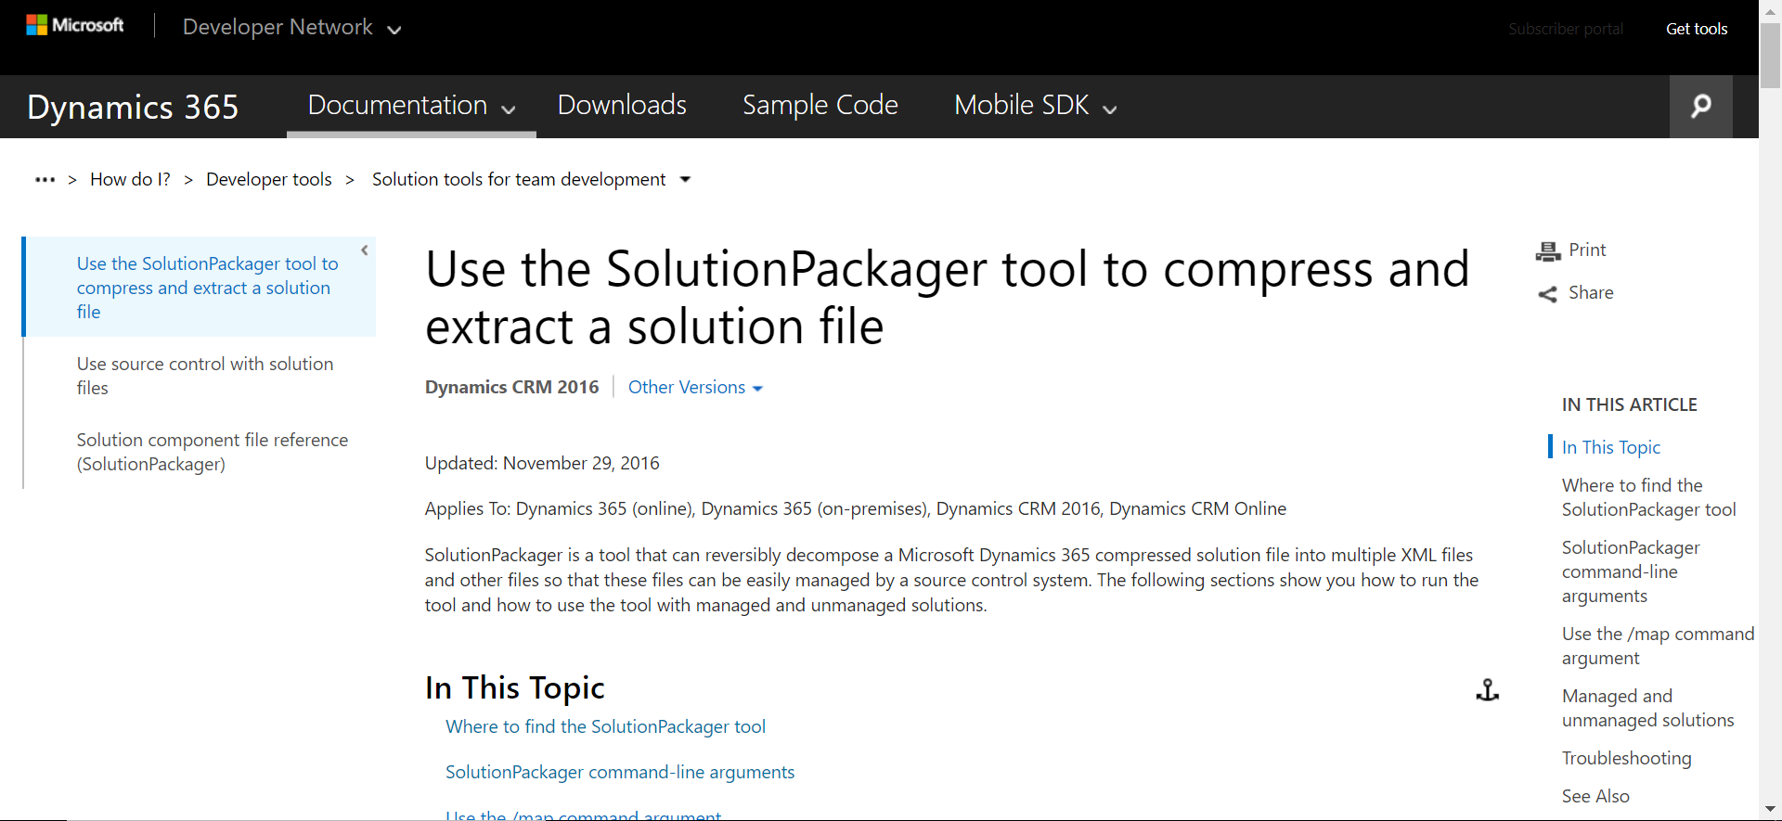
Solution Packager
https://msdn.microsoft.com/en-us/library/jj602987.aspx

Slide 90
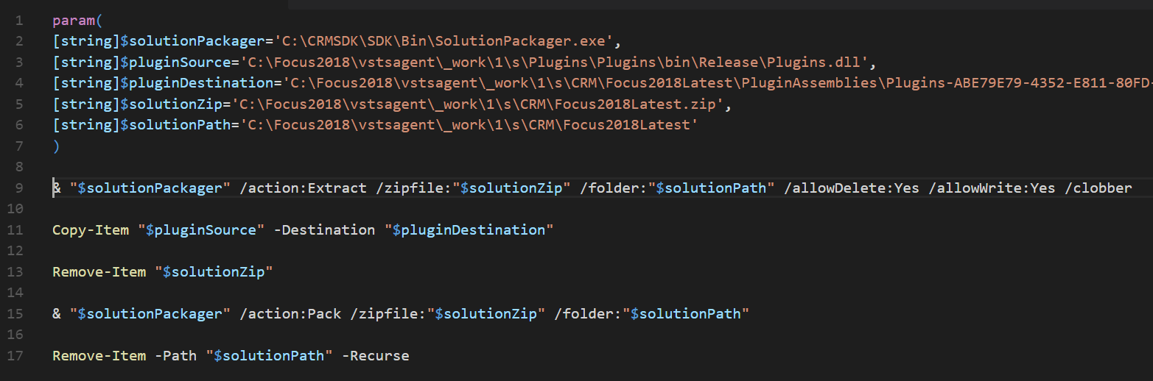
Solution Extract/Pack, Replace Plugin

Slide 91
NEW BUILD STARTED ON BUILD AGENT
Get Source Code from TFVC
NuGet Restore Packages
Build Solutions
SonarQube Static Code Analysis
Unit Tests
Update Solution plugins from source control
CRM Solution Import into SIT Environment
Cucumber / Selenium Automated UI Testing

Slide 92
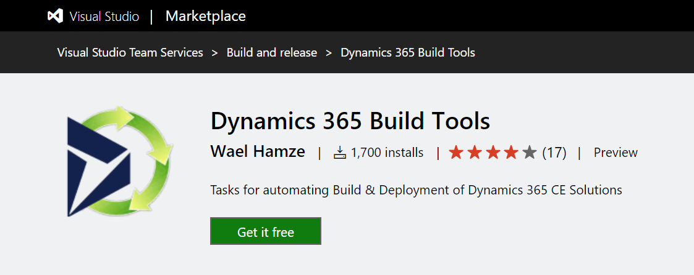
VSTS Extension: XRM CI Framework
https://marketplace.visualstudio.com/items?itemName=WaelHamze.xrm-ci-framework-build-tasks

Slide 93
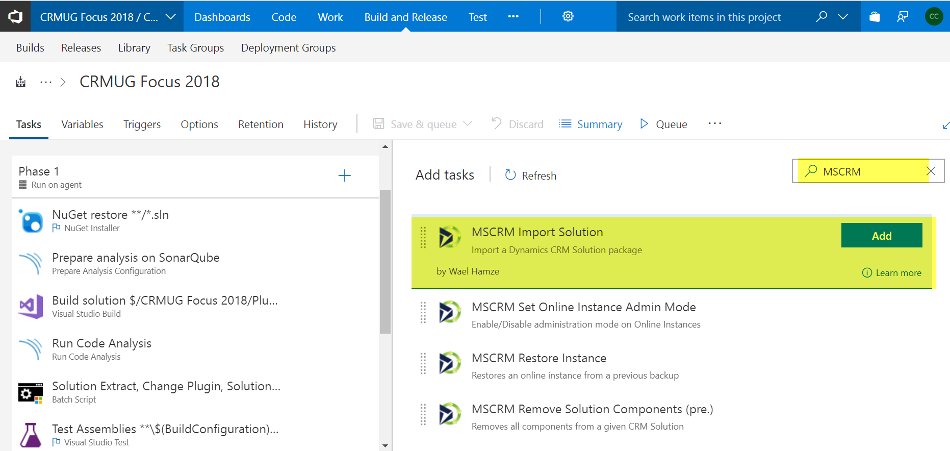
MSCRM Import Solution

Slide 94
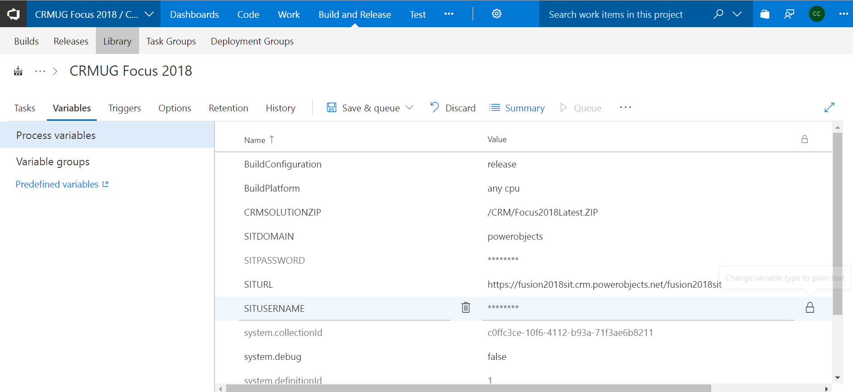
Build Variables

Slide 95
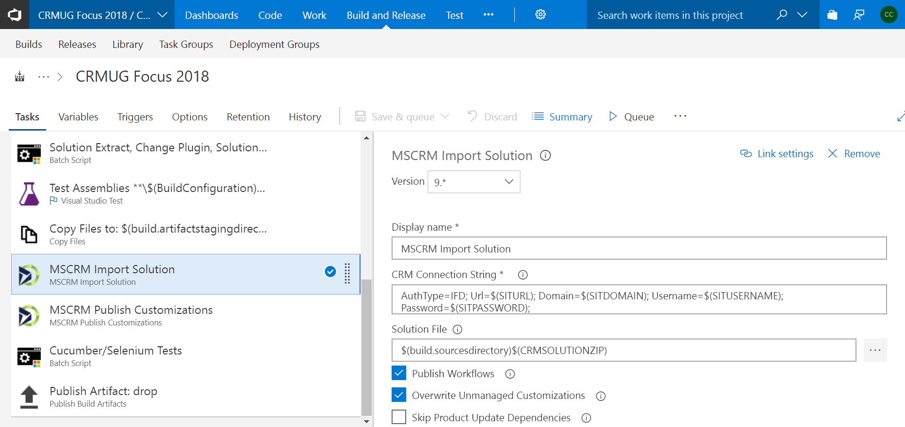
MSCRM Import Solution

Slide 96
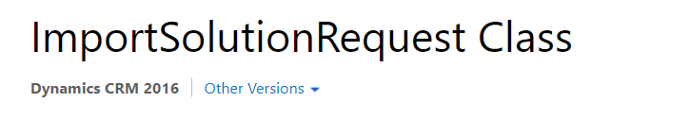

https://msdn.microsoft.com/en-us/library/microsoft.crm.sdk.messages.importsolutionrequest.aspx

Slide 97

VSTS Build Task

Slide 98


https://msdn.microsoft.com/en-us/library/microsoft.crm.sdk.messages.publishallxmlrequest.aspx

Slide 99
NEW BUILD STARTED ON BUILD AGENT
Get Source Code from TFVC
NuGet Restore Packages
Build Solutions
SonarQube Static Code Analysis
Unit Tests
Update Solution plugins from source control
CRM Solution Import into SIT Environment
Cucumber / Selenium Automated UI Testing

Slide 100

Cucumber
Cucumber reads executable specifications written in plain text and validates that the software does what those specifications say. The specifications consists of multiple examples, or scenarios.
Given < all these setup assumptions >
When < I do this thing >
Then < I should see this result >
Each scenario is a list of steps for Cucumber to work through. Cucumber verifies that the software conforms with the specification and generates a report indicating ✅ success or ❌ failure for each scenario.
In order for Cucumber to understand the scenarios, they must follow some basic syntax rules, called Gherkin.
SpecFlow is Cucumber for .NET
http://specflow.org/
https://cucumber.io/
http://docs.cucumber.io/guides/overview/

Slide 101

Gherkin Given / When / Then Statements

Slide 102
Dynamics CRM Create Contact Example
Feature: CreateContact2
@automated
Scenario: Create Contact 1
Given user logs into dynamics 365 sales
And navigates subarea Sales then Contacts
#And switches grid view to Active Contacts
And clicks New button on the ribbon
And enters firstname Chris and lastname Clark in fullname field of type fullname
And enters test@contoso.com in emailaddress1 field of type string
And enters 123-123-1234 in mobilephone field of type string
And enters 11/01/1980 in birthdate field of type datetime
And enters Email in preferredcontactmethodcode field of type optionset
When clicks Save button on the ribbon
Then form should reload
And user should see emailaddress1 field of type string is test@contoso.com

Slide 103
Selenium Browser Automation
Selenium is a Framework for Automating Web Browsers such as Firefox, Chrome, Edge, IE, Safari, Opera, and more…
Developers code to a generic IWebDriver interface in Java, C#, Ruby, Python, or Javascript.
Code is executed against a specific Browser Host application which implements IWebDriver for their specific web browser.
https://www.seleniumhq.org/download/
https://www.seleniumhq.org/

Slide 104
Microsoft / EasyRepro
CRM Functionality Covered
Activity Record Wall
Business Process Flow
Charts
Commandbar
Dashboards
Entities (Create, Update, Delete, Duplicate Detection, Assign)
Global Search
CRM Functionality Not Covered
Settings Area (Administration)
Customization
Advanced Find Query execution(Open Advanced Find is available)
Export to Excel
Templates
Other Add on Applications
Guided Help
Grids
Sub-Grids
Navigation
Notifications
Performance Center
Quick Create
Run Workflows
Run Reports
The purpose of this library is to provide Dynamics customers the ability to facilitate automated UI testing for their projects. These API's provide an easy to use set of commands that make setting up UI testing quick and easy.
https://github.com/Microsoft/EasyRepro

Slide 105
Easy Dynamics CRM UI Automation
Cucumber – Define Features and Test Scenarios
SpecFlow – Map Scenario Steps to C# Functions
Microsoft EasyRepro – Selenium Dynamics UI Automation Code
Selenium Browser Host (Chrome, Firefox, IE, Edge)

Slide 106


Given user logs into dynamics 365 sales

Slide 107


And navigates subarea Sales then Contacts

Slide 108


And clicks New button on the ribbon

Slide 109


And enters firstname Chris and lastname Clark in fullname field of type fullname

Slide 110



And enters test@contoso.com in emailaddress1 field of type string

Slide 111


And user should see emailaddress1 field of type string is test@contoso.com

Slide 112
Release Management

Slide 113


VSTS Release Definition

Slide 114

VSTS Release Definition

Slide 115

VSTS Release Definition

Slide 116

VSTS Release Definition

Slide 117

VSTS Release Definition

Slide 118

VSTS Release Definition

Slide 119

VSTS Release Definition

Slide 120

VSTS Release Definition

Slide 121
VSTS Release Definition

Slide 122

VSTS Release Definition

Slide 123

VSTS Release Definition

Slide 124
Jenkins Server

Slide 125

Single organization: One master solution
Get Latest Solution / Code
Code Built From Source
Static Code Analysis
Unit Tests
Git
Rebuild Plugins
Solution Deployed
Data Deployed
Automated UI Testing
JENKINS
DEV
SIT
SAT
UAT
PROD
Notes:
Multiple developers can work on a single organization; however, they have to be careful to work on separate components. This is easier when any prerequisite managed solutions (shared libraries) are installed first.

Slide 126
Jenkins Developer Check-In GIT
Increase CRM Solution Version 1.0.0.X
Export CRM DEV Solution
Copy CRM DEV Solution to CRM Folder
Add Files to GIT
Commit Files to GIT
Push Files to GitHub
Force New Jenkins Build

Slide 127
Build Process
Get Sources
New Get Restore Packages
Build
SonarQube Analysis
Unit Tests
CRM Solution Import into SIT Environment
Cucumber / Selenium Automated UI Testing

Slide 128

Jenkins Server
https://jenkins.io/

Slide 129

Jenkins Continuous Integration / Delivery

Slide 130

Create New Job

Slide 131

Create Freestyle Project

Slide 132

Specify GitHub Project

Slide 133

Specify Repository, Creds, Branch

Slide 134

Trigger build remotely via URL w/ Token

Slide 135


Slide 136

Developer Check-In GIT

Slide 137

PowerShell Script

Slide 138
Operations / Monitoring

Slide 139

Dynamics Operations and Measurement

Slide 140
Dynamics CRM Monitoring On-Premises
Monitoring Dynamics CRM Infrastructure
Services Health
Performance Counters
End-to-End Testing
https://www.slideshare.net/StphaneDorrekens/monitoring-a-dynamics-crm-infrastructure
Microsoft Dynamics 365 Monitoring Service
The monitoring service validates the health of the server roles that are running on the local computer by running a series of tests. By default, monitoring occurs every 15 minutes and 10 records are maintained before the earliest record is replaced.
https://technet.microsoft.com/en-us/library/dn905215.aspx
System Center Management Pack for Dynamics CRM 2016
The Operations Manager management pack for CRM enables you to monitor Microsoft Dynamics CRM Server 2016 and Microsoft Dynamics CRM Server 2015 in Microsoft System Center Operations Manager.
https://www.microsoft.com/en-us/download/details.aspx?id=50379

Slide 141
Organization Insights for Dynamics 365
Organization Insights for Dynamics 365 (online) provides important adoption and usage metrics for your Dynamics 365 organization, and tools to help you stay ahead of performance and support issues.
Customize dashboards: Set up your organization’s dashboard to provide a rich user experience and snapshots of your organization’s most important data.
Monitor adoption and use: Identify your most active users, the number and types of operations they’re performing, number of page requests, most-used entities, workflows, plug-ins, and more, over a period of time as you work toward your adoption goals.
Manage storage and performance: Monitor storage quotas, storage use, and common tables by size to optimize performance.
Troubleshoot effectively: Drill down into the details of your top failing workflows and API calls to quickly diagnose and troubleshoot errors.
OData support: Organization Insights entities are exposed through OData for independent software vendors to build capabilities for any custom requirements.
https://appsource.microsoft.com/en-us/product/dynamics-365/mscrm.04931187-431c-415d-8777-f7f482ba8095?tab=Overview

Slide 142

Dynamics Organization Insights

Slide 143

Dynamics Organization Insights

Slide 144

Dynamics Organization Insights

Slide 145

Dynamics Organization Insights

Slide 146

Dynamics Organization Insights

Slide 147
Other Stuff

Slide 148
Feature Flags
Working around the central issue there are no two simultaneous versions of the same Dynamics CRM component
There are going to be things you just can’t hide
Custom Entity for Configuration at User Level
Security Roles
Conditional Logic – Plugins, Web Resources
Security Role to Distinguish Forms, Dashboards

Slide 149
Things that don’t transfer with Solutions
Duplicate detection rules / publish them
Multi-Entity search configuration
Re-name Views/forms
Activate/inactivate Views/forms
Set Hierarchy depth
Set Full name format in System Settings
Changing an Attribute data type

Slide 150
Configuration Migration Tool

Slide 151

Configuration Migration Tool
Use this tool to export data from one CRM organization to another. Also can create data which can be used with the Package Deployer.
https://msdn.microsoft.com/en-us/library/dn688182.aspx
C:\CRMSDK\SDK\Tools\ConfigurationMigration

Slide 152
Package Deployer

Slide 153
Dynamics CRM Package Deployer
Microsoft Dynamics CRM Package Deployer lets administrators deploy packages on Microsoft Dynamics 365 (online) and Dynamics 365 (on-premises) instances. A “package” can consist of any or all of the following:
One or more Dynamics 365 solution files.
Flat files or exported configuration data file from the Configuration Migration tool. For more information about the tool, see TechNet: Manage your configuration data.
Custom code that can run before, while, or after the package is deployed to the Dynamics 365 instance.
HTML content specific to the package that can display at the beginning and end of the deployment process. This can be useful to provide a description of the solutions and files that are deployed in the package.
Microsoft Dynamics 365 provides you with a Visual Studio template for creating these packages that can be used with the Package Deployer tool to deploy them to a Dynamics 365instance.
https://msdn.microsoft.com/en-us/library/dn688182.aspx
C:\CRMSDK\SDK\Tools\PackageDeployer

Slide 154

Dynamics CRM Package Deployer
https://msdn.microsoft.com/en-us/library/dn688182.aspx
https://www.youtube.com/watch?v=KJKZPu4C-O4

Slide 155
Packages Deployed via Powershell
The Get-CrmPackages cmdlet returns a list of packages (package name and package assembly location). The cmdlet can also return information about a specific package if you specify the package name as a cmdlet parameter. A package can contain the following items Microsoft Dynamics 365 solution files, files or exported data files from the Configuration Migration tool, custom code that can run during or after the package is deployed to the Microsoft Dynamics 365 instance, and HTML content specific to the package that can display at the beginning and end of the package deployment process. This HTML content can be useful to provide a description of the solutions and files that are deployed in the package. This cmdlet applies to Microsoft Dynamics 365 (online and on-premises).
PS C:\> Get-CrmPackages [[-PackageDirectory] <String> ] [[-PackageName] <String> ] [-LogWriteDirectory <String> ] [ <CommonParameters>]
The Import-CrmPackage cmdlet imports a package to a Dynamics 365 instance. A package can contain Dynamics 365 solution files, files or exported data files from the Configuration Migration tool, custom code that can run during or after the package is deployed to the Dynamics 365 instance, and HTML content specific to the package that can display at the beginning and end of the package deployment process. The HTML content can be useful to provide a description of the solutions and files that are deployed in the package.
PS C:\> Import-CrmPackage [-CrmConnection] <String> [-PackageName] <String> [[-PackageDirectory] <String> ] [[-UnpackFilesDirectory] <String> ] [-AllowCustomCode <String> ] [-LogWriteDirectory <String> ] [-RuntimePackageSettings <String> ] [-Timeout <String> ]
https://www.youtube.com/watch?v=EOLjjwY0QEQ

Slide 156
Package Deploy Example
$Cred = Get-Credential
Add-PSSnapin Microsoft.Xrm.Tooling.Connector
Add-PSSnapin Microsoft.Xrm.Tooling.PackageDeployment
$CRMConnection = Get-CrmConnection -OrganizationName Contoso -ServerUrl http://mycrmserver -Credential $Cred
Import-CrmPackage -CrmConnection $CRMConnection -PackageDirectory $PackageDirectory -PackageName MyPackage.dll -Verbose

Slide 157
PowerShell

Slide 158
Microsoft Dynamics 365 Management Cmdlets
Administer your On-Premises CRM deployment using Powershell. With Windows PowerShell you can easily run deployment commands to change the configuration of your deployment, like tasks that can be performed from the Deployment Manager user interface. You can also use the methods described in the Microsoft Dynamics 365 SDK to perform these tasks. The PowerShell cmdlets are installed on the computer when you install a Full Server role or when you install the Deployment Tools server role, if you’re installing individual server roles. To execute commands, you must first register the Microsoft Dynamics 365 commands with PowerShell.
PS c:\crmsdk\bin> Add-PSSnapin Microsoft.Crm.PowerShell
https://technet.microsoft.com/en-us/library/dn756318.aspx#Mgmt_cmd

Slide 159
Connector Cmdlets
cd c:\crmsdk\bin
c:\crmsdk\bin> .\RegisterXRMTooling.ps1
PS c:\crmsdk\bin> Add-PSSnapin Microsoft.Xrm.Tooling.Connector
https://technet.microsoft.com/en-us/library/dn756318.aspx#Conn_cmd
Name | Description
Get-CrmConnection | Returns a connection to a Microsoft Dynamics 365 instance.
Get-CrmOrganizations | Returns a list of Microsoft Dynamics 365 online or Microsoft Dynamics 365 on-premises organizations.

Slide 160
Package Deployment Cmdlets
cd c:\crmsdk\bin
c:\crmsdk\bin> .\RegisterXRMTooling.ps1
PS c:\crmsdk\bin> Add-PSSnapin Microsoft.Xrm.Tooling.Connector
PS c:\crmsdk\bin> Add-PSSnapin Microsoft.Xrm.Tooling.PackageDeployment
https://technet.microsoft.com/en-us/library/dn756318.aspx#Pkg_cmd
Name | Description
Get-CrmPackages | Returns a list of available packages that can be deployed to a Microsoft Dynamics 365 online instance or Dynamics 365 on-premises organization.
Import-CrmPackage | Imports a package to a Microsoft Dynamics 365 online instance or Dynamics 365 on-premises organization.

Slide 161
Dynamics 365 Online Management API
Create, Backup, Restore, Delete Instances
PS> Save-Module -Name Microsoft.Xrm.OnlineManagementAPI -Path <path> -RequiredVersion 0.0.1.0
PS> Install-Module -Name Microsoft.Xrm.OnlineManagementAPI -RequiredVersion 0.0.1.0
Backup-CrmInstance Disable-CrmAdminMode Disable-CrmManagementApp Enable-CrmAdminMode Enable-CrmManagementApp Get-CrmCurrencys Get-CrmInstance Get-CrmInstanceBackup Get-CrmInstanceBackups Get-CrmInstances Get-CrmInstanceType Get-CrmInstanceTypes Get-CrmLanguages Get-CrmManagementApp Get-CrmManagementApps Get-CrmOperationStatus Get-CrmServiceVersions Get-CrmTemplates New-CrmAdminModeSetting New-CrmBackupInfo New-CrmInstance New-CrmInstanceInfo New-CrmManagementApp Remove-CrmInstance Remove-CrmManagementApp Restore-CrmInstance
https://www.powershellgallery.com/packages/Microsoft.Xrm.OnlineManagementAPI/0.0.1.0

Slide 162

The End

Slide 164
Appendix

Slide 165

Async Solution Import
Conclusion:
The main advantage of an asynchronous solution import is, the users who are interacting with the system will not face SQL timeout issues when the solution is being imported asynchronously.
https://community.dynamics.com/crm/b/crminogic/archive/2014/05/21/asynchronous-solution-import

Slide 166
Lean Software Started with Guns
1785, Paris, France, Honoré Blanc gunsmith shop in military leaders and high ranking officials. Interchangeable parts made into musket locks.
1798, Thomas Jefferson, Eli Whitney government contract to make 10,000 guns in two years. Over budget and 10 years later. "American system of manufacture," semi-skilled workers make standardized parts assembled into products.
1908, Sakichi Toyoda recruited an American engineer, Charles A. Francis, to bring the American system of manufacture to his company. He developed standard specifications, produced standardized gauges and jigs, and reorganized the manufacturing line.
1914, Detroit, USA, Henry Ford, Model T. Paid more, less labor, cheaper product. Ford ideas of Frederick Winslow Taylor. Divided process into simple steps with best method. Employees replaceable. Ford stagnated with Model T, but consumers wanted choice. 1925 GM surpassed Ford and kept ahead until 1986.
1921 Sakichi Toyoda's son Kiichiro joined advancing loom automation. Kiichiro started up an automotive business. He toured Detroit and spent years learning how to build engines. Toyota's first car in 1936.
1927, Kariya, Japan, Toyoda Automatic Loom Works fully automatic and could run unattended all night.
1945, Kiichiro Toyoda had challenged "catch up with America.“ Kiichiro Toyoda's vision "Just-in-Time“
1962, a decade after Kiichiro Toyoda's death, adopted Toyota Production System companywide.
1948- 1975, Toyota Production System. Taiichi Ohno and Eiji Toyoda. Built upon JIT process developed by Sakichi Toyoda, his son Kiichiro Toyoda, and the engineer Taiichi Ohno.

Slide 167
Lean Production into Lean Software
1990, the book The Machine That Changed the World⁹ gave a new name to what had previously been called Just-in-Time or the Toyota Production System. Thus invented Lean Production.
1991, Grady Booch, Object Oriented Design: With Applications
1991, Rapid Application Development
1994, Unified Process and Dynamic Systems Development Method
1995, Scrum
1996, Crystal Clear and extreme programming (XP), Kent Beck, Ward Cunningham, Ron Jeffries
1997, Feature Driven Development
2001, Manifesto for Agile Software Development
2003, Lean software development: An Agile Toolkit by Mary & Tom Poppendieck.
2005, Declaration of Interdependence
2007, Scaled Agile Framework, Scaling Software Agility: Best Practices For Large Enterprises
2009, Software Craftmanship Manifesto
2010, Agile Software Requirements: Lean Requirements Practices for Teams, Programs, and the Enterprise
2011, Guide to Agile Practices, renamed Agile Glossary in 2016

Slide 168
Lean principles
Eliminate waste – Always Adding Value
Amplify learning – Fail, Forward, Fast
Decide as late as possible – Develop Options
Deliver as fast as possible – Time to Market
Empower the team – Remove Roadblocks
Build integrity in – Quality Product
See the whole – Sum of Parts

